Slide 1
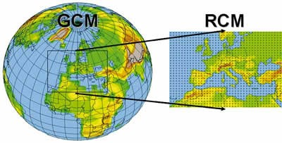








WP2. Earth system models at regional scales
Jerry Tjiputra, Momme Butenschon, Tomas Lovato, Jean Negrel, et al.

Slide 2
WP2 Objectives
Develop Earth system models (ESMs) evaluation tool tailored to CE2COAST key domains;
Objectively assess and benchmark ESMs skill at regional scale;
Determine key large-scale climate change features affecting regional hydrography and biogeochemistry in the 21st century;
Quantify source and propagation of ESM uncertainties in their projections;
Provide benchmarks for dynamically downscaled simulations.

Slide 3
WP2 Tasks
T2.1. Assessment and prioritization of approaches to evaluate ESM skill
T2.2. Validation of ESMs at regional and coastal levels
T2.3. Benchmark for each regional system from ESM projection data
T2.4. Analysis of natural variability as a proxy for potential thresholds
T2.5. Identify potential emergent constraints
T2.6. Identify large-scale patterns and teleconnections with impacts on regional scales

Slide 4
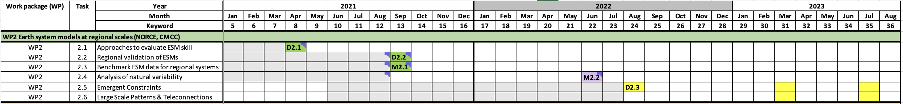
WP2 Milestones & Deliverables
M2.1. Benchmark ESM data and related observational data for regional systems in project database (T1.1) (CMCC lead; September 2021). Achieved.
M2.2. Report on uncertainty range and natural thresholds of ecosystem drivers (June 2022). Achieved.
D2.1. Validation toolkit for the evaluation of ESM performance at regional scale (CMCC lead; April 2021). Delivered.
D2.2. Report on ESMs performance and ranking at regions of interest (NORCE lead; September 2021). Delivered.
D2.3. Report on relevant emergent constraints and mechanisms of propagation across the regional systems and systematic biases (NORCE lead; March 2023).

Slide 5
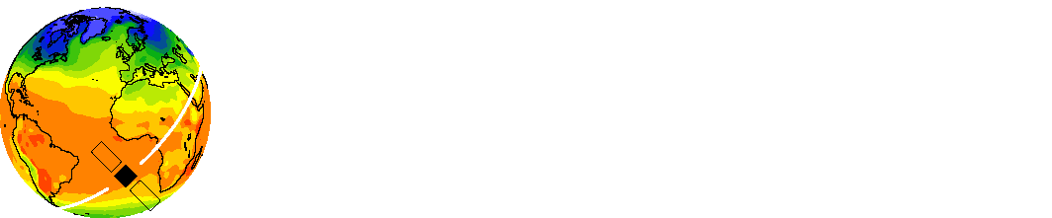
D2.1. Validation toolkit for the evaluation of ESM performance at regional scale (April 2021). Delivered.

Slide 6
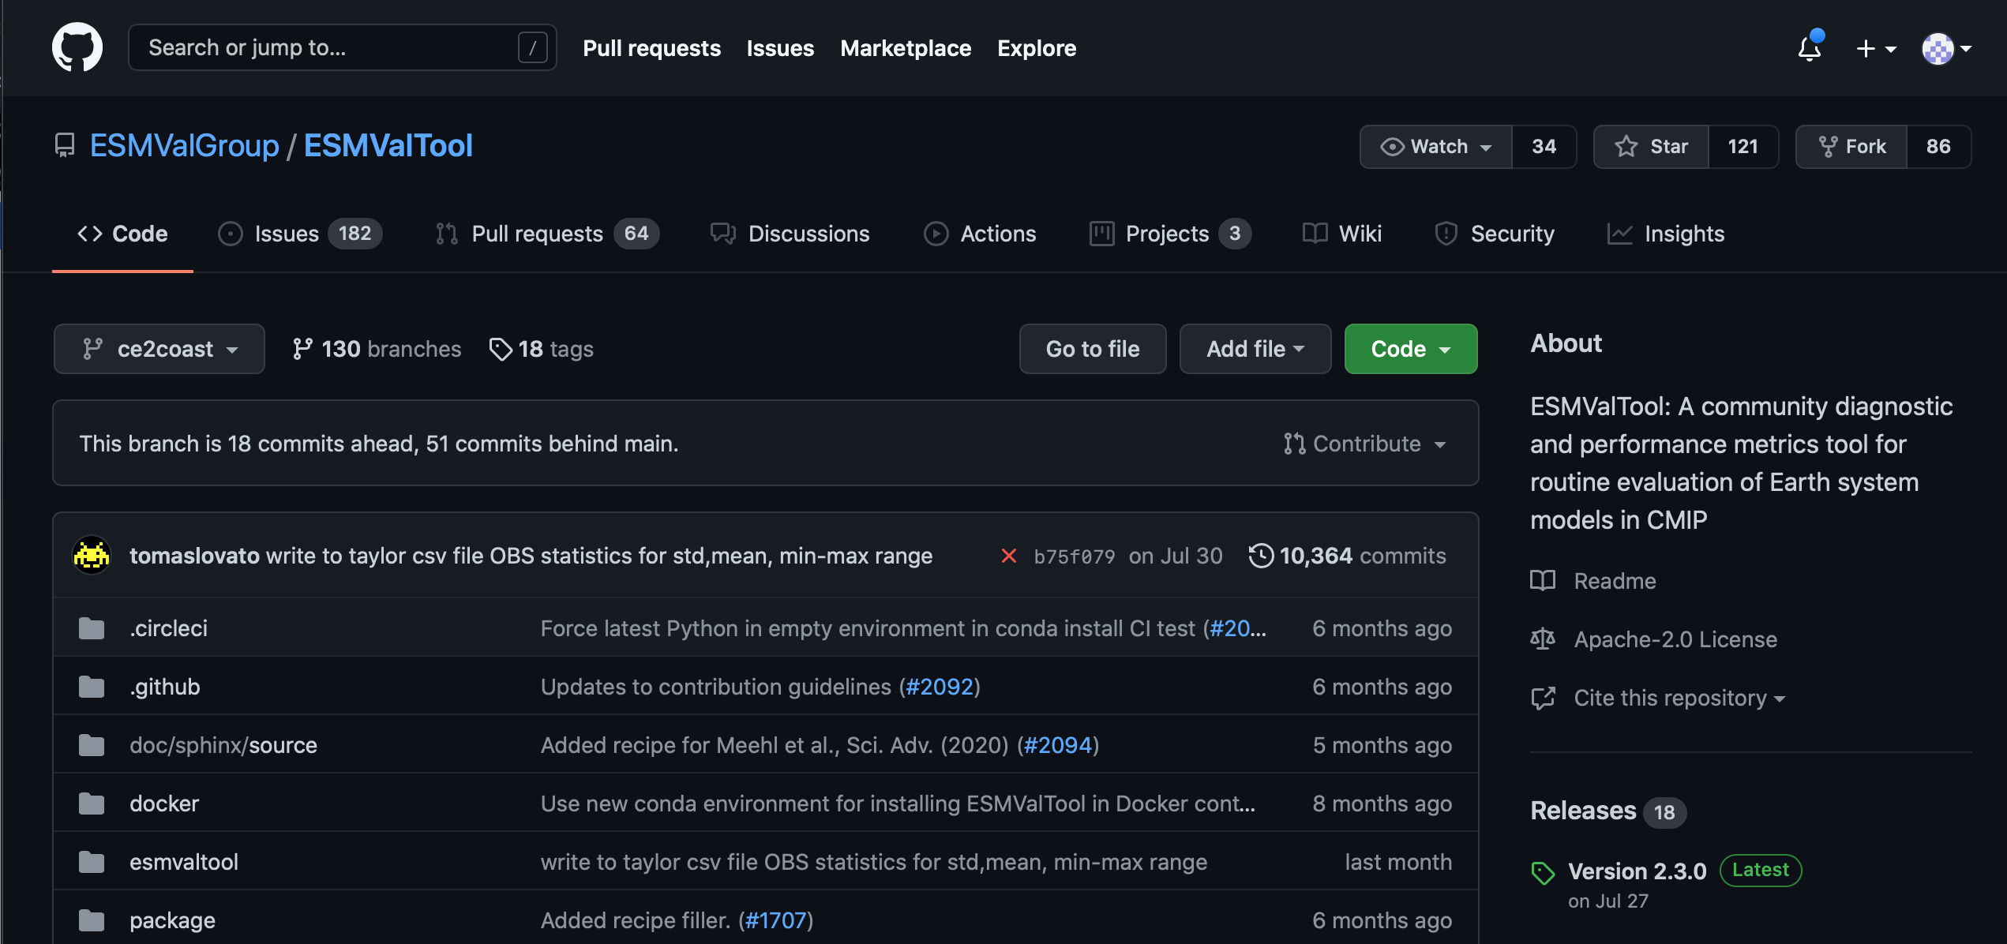
D2.1. Validation toolkit for the evaluation of ESM performance at regional scale (April 2021). Delivered.
CE2COAST-based regional ESMValTool extension
ESMValTool (https://github.com/ESMValGroup/ESMValTool/tree/ce2coast)
ESMValCore (https://github.com/ESMValGroup/ESMValCore/tree/ce2coast).
A start-up guide and two regional evaluation examples are available in project Teams.

Slide 7
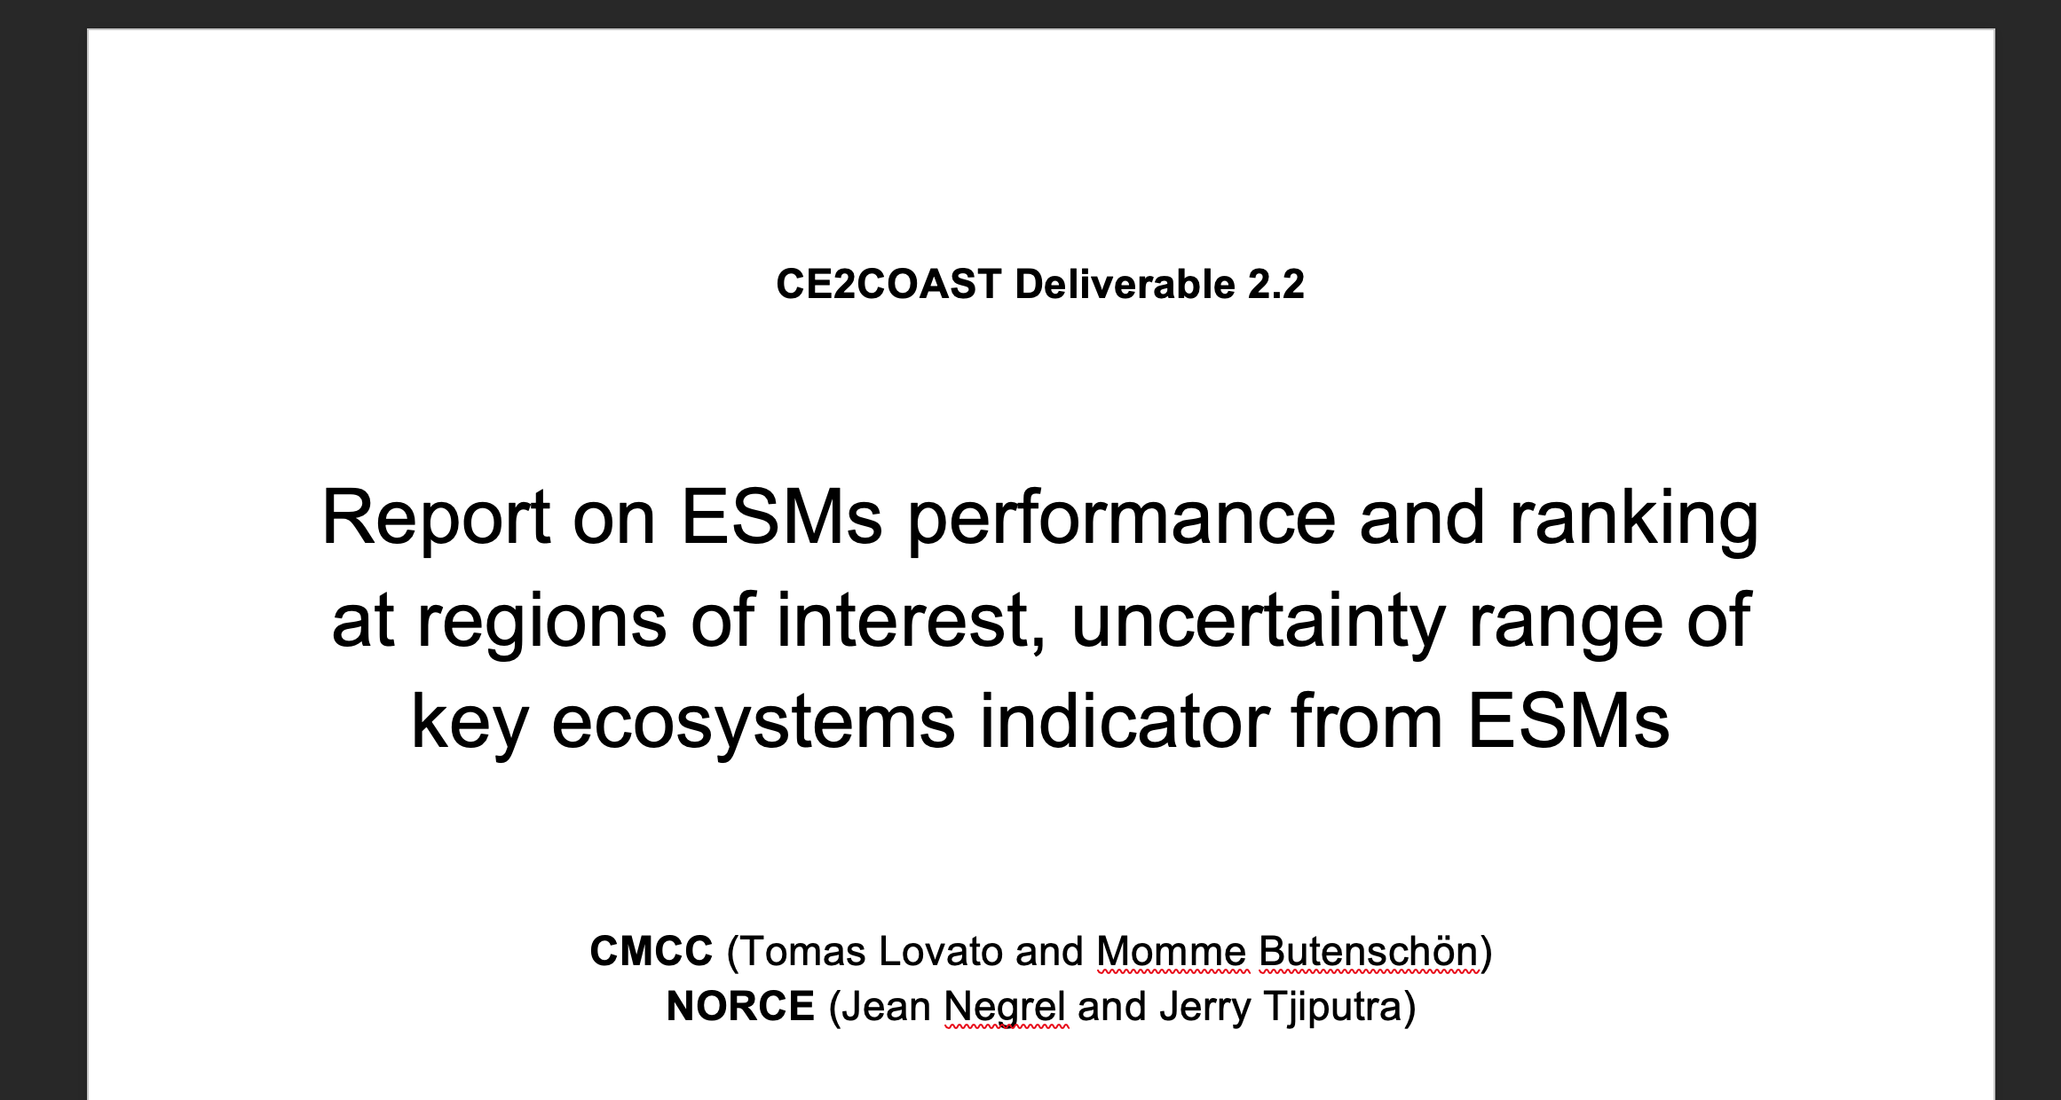
D2.2. Report on ESMs performance and ranking at regions of interest (sept. 2021).

Slide 8
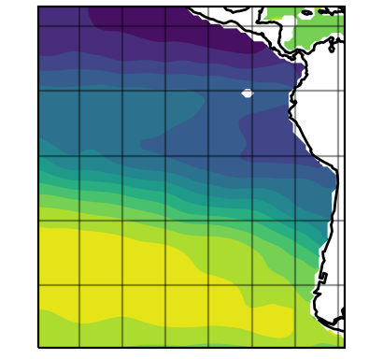
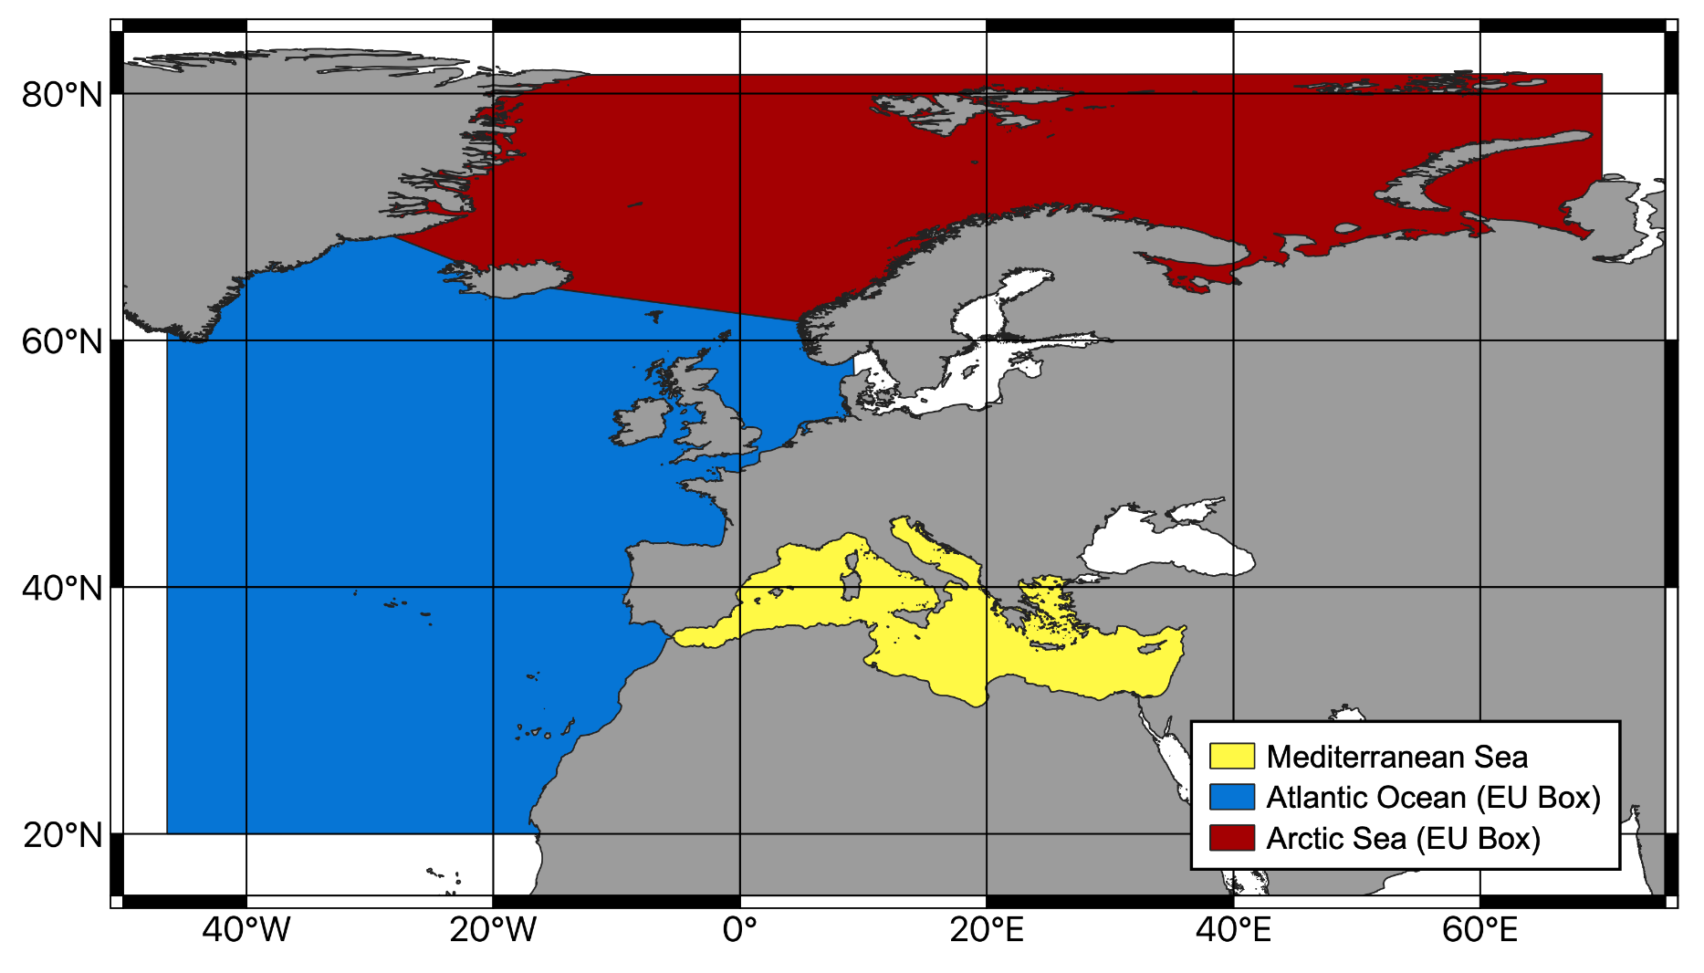
D2.2. Report on ESMs performance and ranking at regions of interest (Sept. 2021).
Meeting with Pacific subgroup (14.05.2021)
Meeting with Atlantic subgroup (10.06.2021)
Domains, temporal scale, and key parameters defined.

Slide 9
model | variant | tos | fgco2 | intpp | thetao | so | no3 | o2 | dissic | talk | ph
ACCESS-ESM1-5 | r1i1p1f1 | x | x | x | x | x | x | x | x | x | N/A
CanESM5 | r1i1p2f1 | x | x | x | x | x | x | x | x | x | x
CanESM5-CanOE | r1i1p2f1 | x | x | x | x | x | x | x | x | x | x
CESM2 | r4i1p1f1 | x | x | x | x | x | x | N/A | x | x | x
CESM2-WACCM | r1i1p1f1 | x | x | x | x | x | x | N/A | x | x | x
CMCC-ESM2 | r1i1p1f1 | x | x | x | x | x | x | x | x | x | x
CNRM-ESM2-1 | r1i1p1f2 | x | x | x | x | x | x | x | x | x | x
EC-Earth3-CC | r1i1p1f1 | x | x | x | x | x | x (Oyr) | x (Oyr) | x (Oyr) | x (Oyr) | x (Oyr)
GFDL-CM4 | r1i1p1f1 | x | x | x | x | x | N/A | x | x | x | x
GFDL-ESM4 | r1i1p1f1 | x | x | x | x | x | x | x | x (Oyr) | x (Oyr) | x
IPSL-CM6A-LR | r1i1p1f1 | x | x | x | x | x | x | x | x | x | x
MPI-ESM1-2-HR | r1i1p1f1 | x | x | x | x | x | x | x | x | x | x
MPI-ESM1-2-LR | r1i1p1f1 | x | x | x | x | x | x | x | x | x | x
MRI-ESM2-0 | r1i2p1f1 | x | x | x | x | x | x (Oyr) | x (Oyr) | x | x | x
NorESM2-LM | r1i1p1f1 | x | x | x | x | x | x | x | x | x | x
UKESM1-0-LL | r1i1p1f2 | x | x | x | x | x | x | x | x | x | x
OBS |  | ESACCI-SST | Landschuetzer 2016 | Eppley MODIS | WOA18 | WOA18 | WOA18 | WOA18 | GLODAP | GLODAP | GLODAP

Slide 10
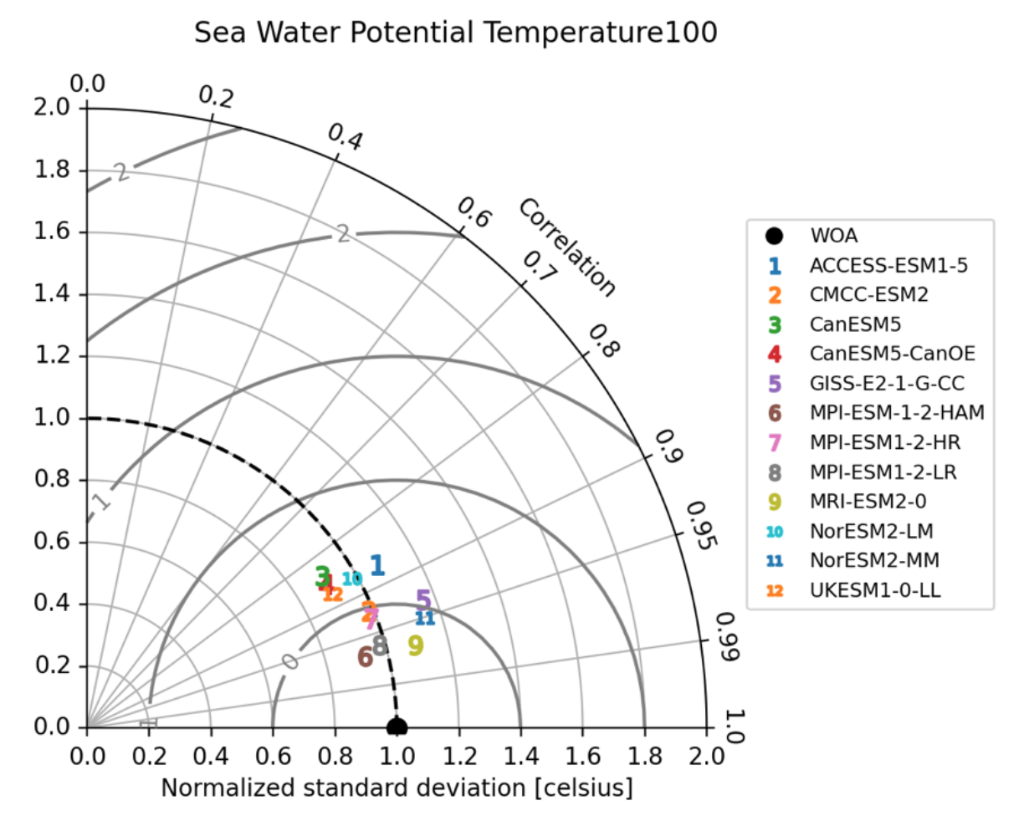
D2.2. Report on ESMs performance and ranking at regions of interest (sept. 2021).

Slide 11
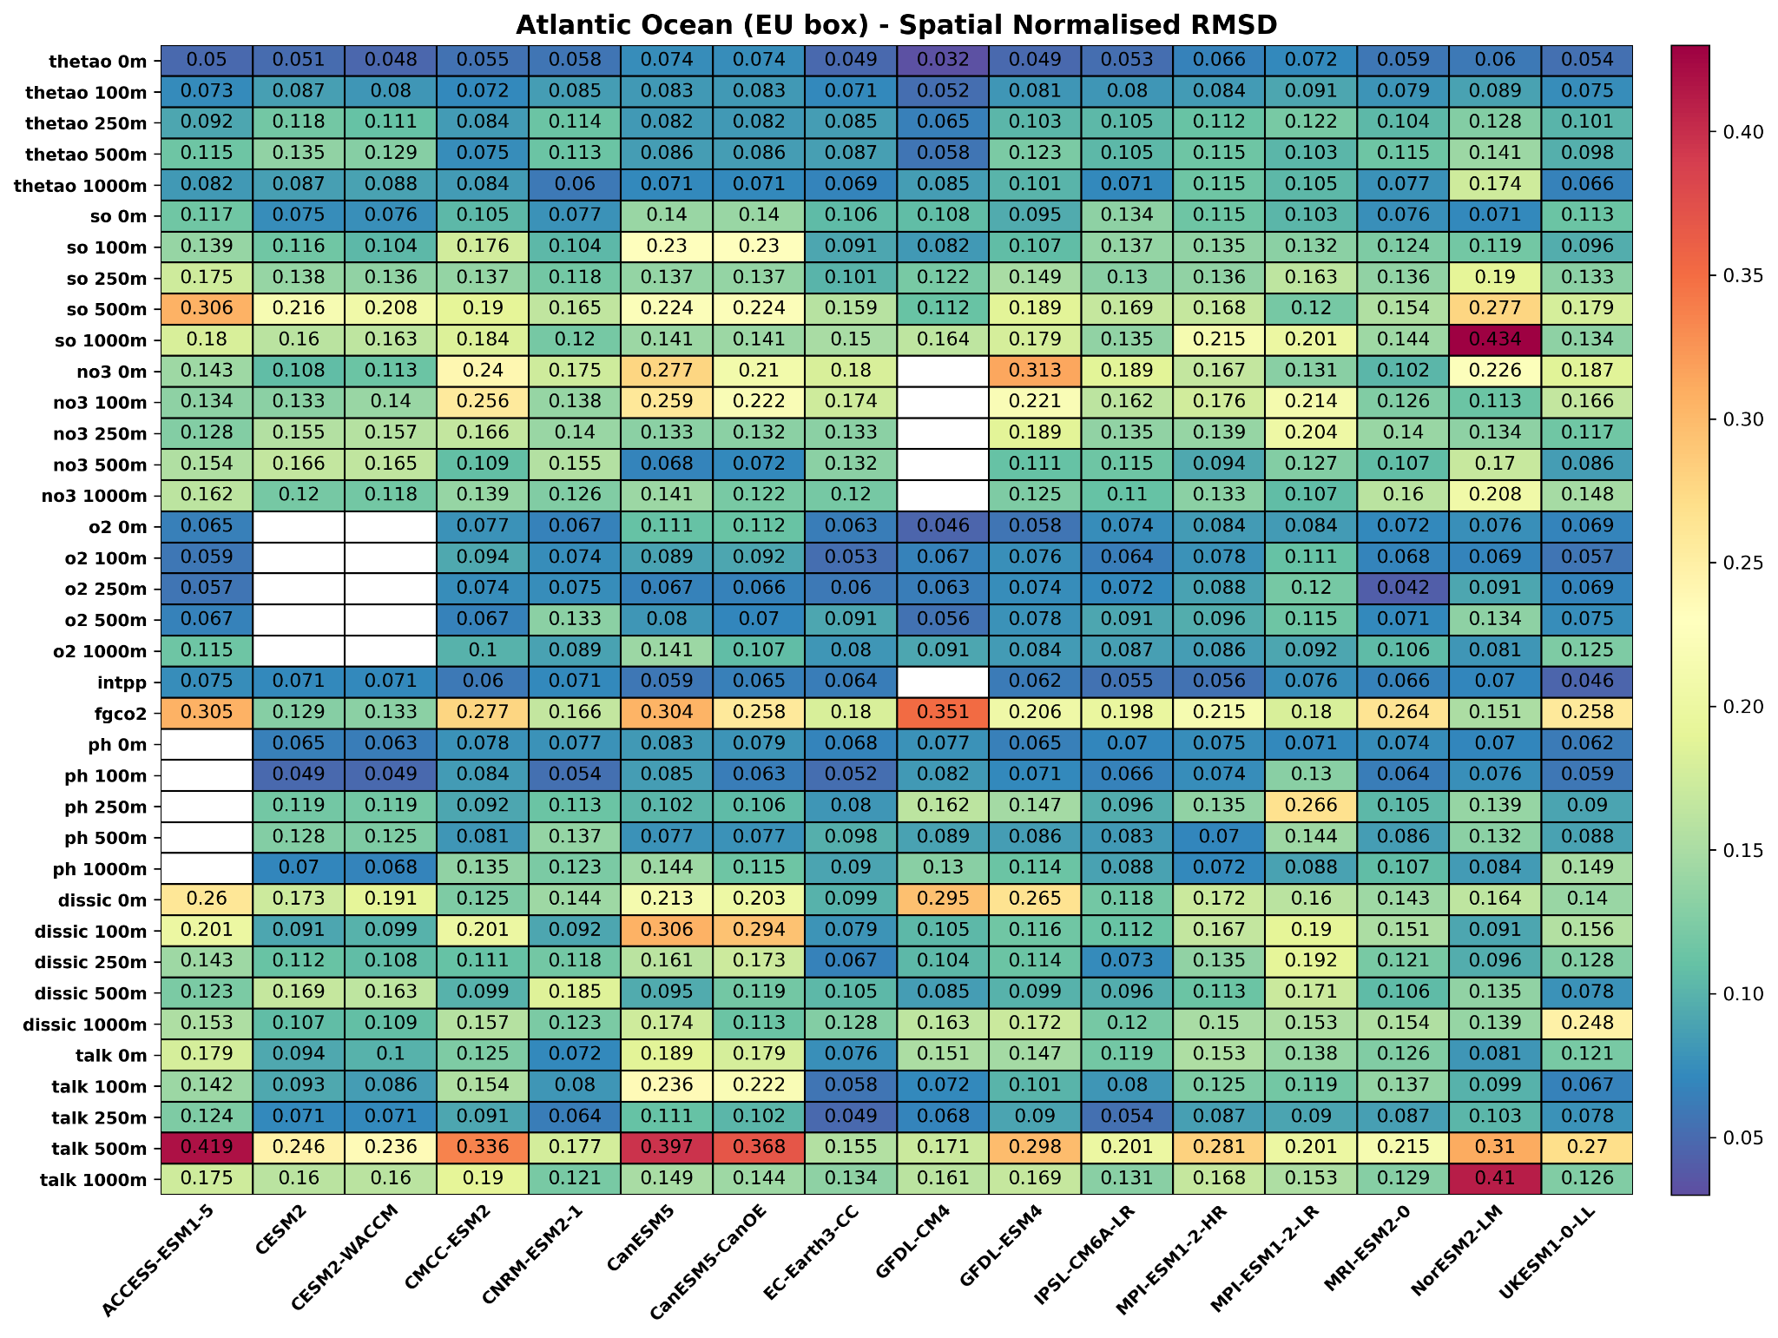
D2.2. Report on ESMs performance and ranking at regions of interest (sept. 2021).

Slide 12
D2.2. Report on ESMs performance and ranking at regions of interest (sept. 2021).

Slide 13
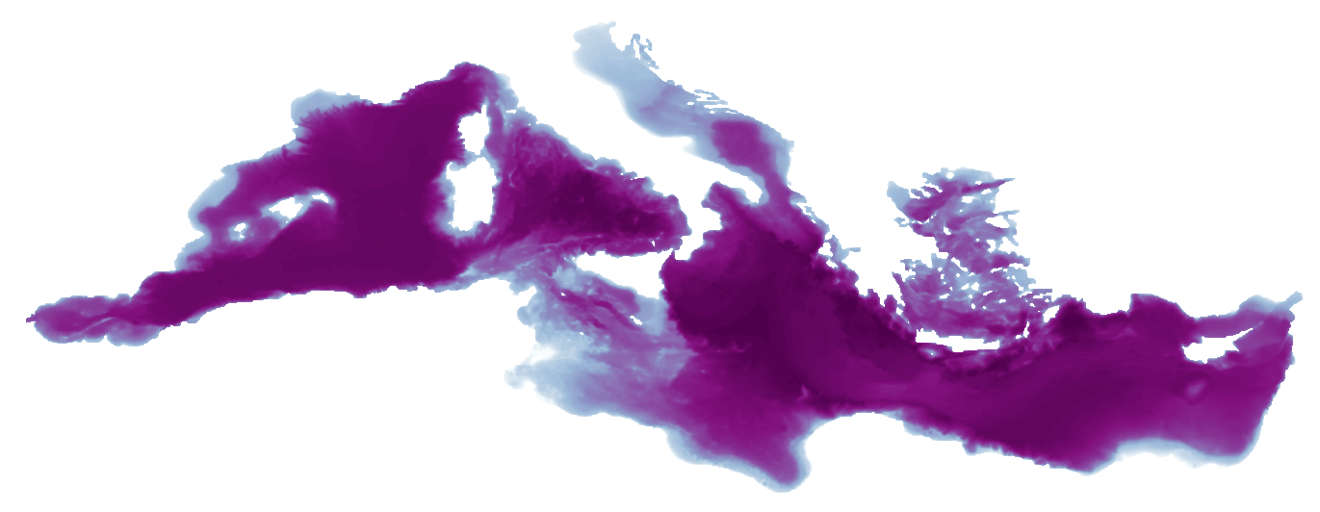
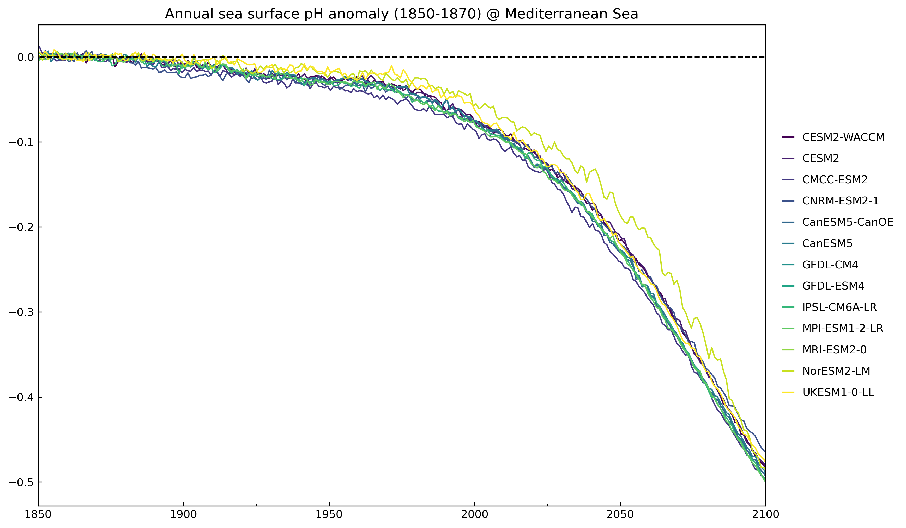
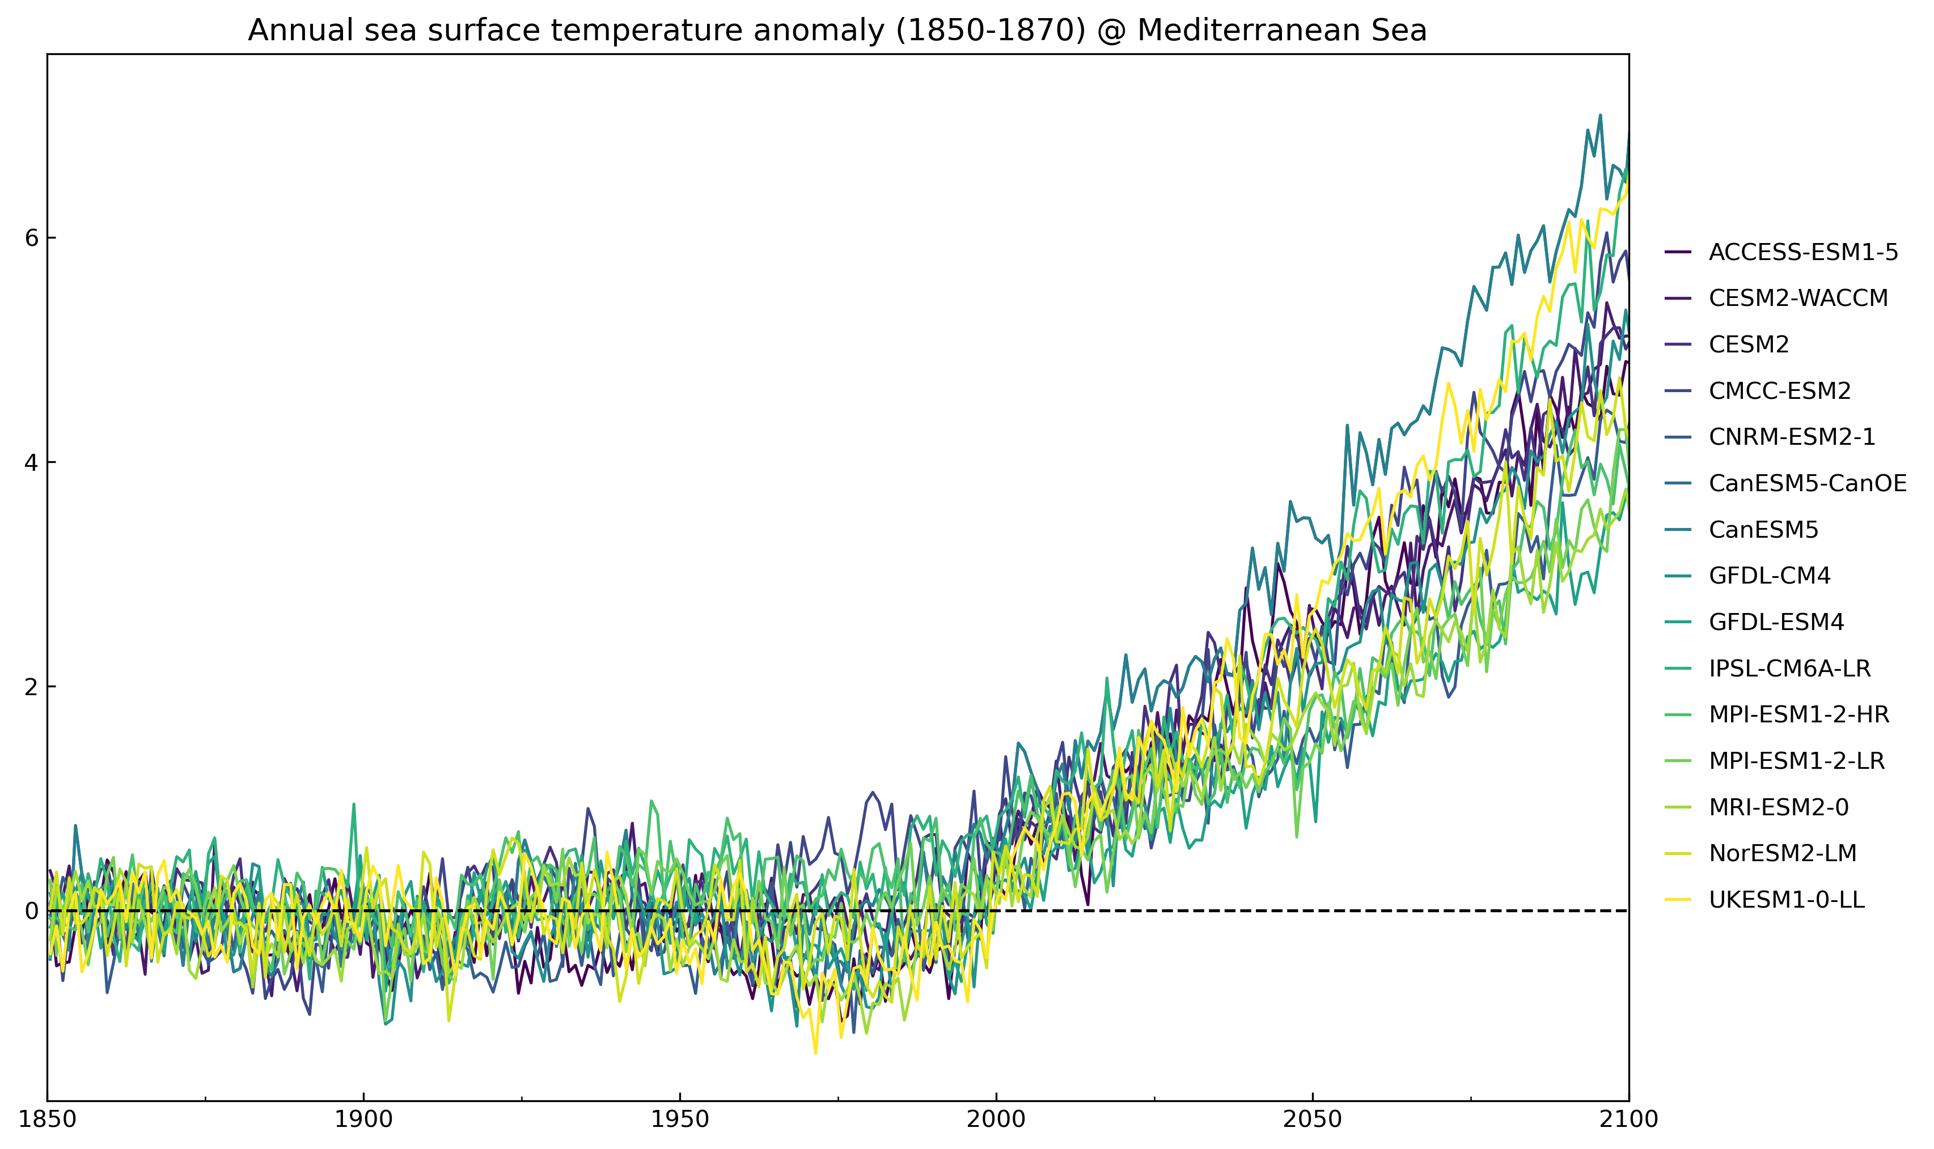
T2.3. Benchmark for each regional system from ESM projection data T2.4. Analysis of natural variability as a proxy for potential thresholds
Mediterranean domain
Momme Butenschon, Tomas Lovato
CMCC, Italy
Sea Surface Temparture
Surface pH
Anomaly wrt pre-industrial climatology

Slide 14
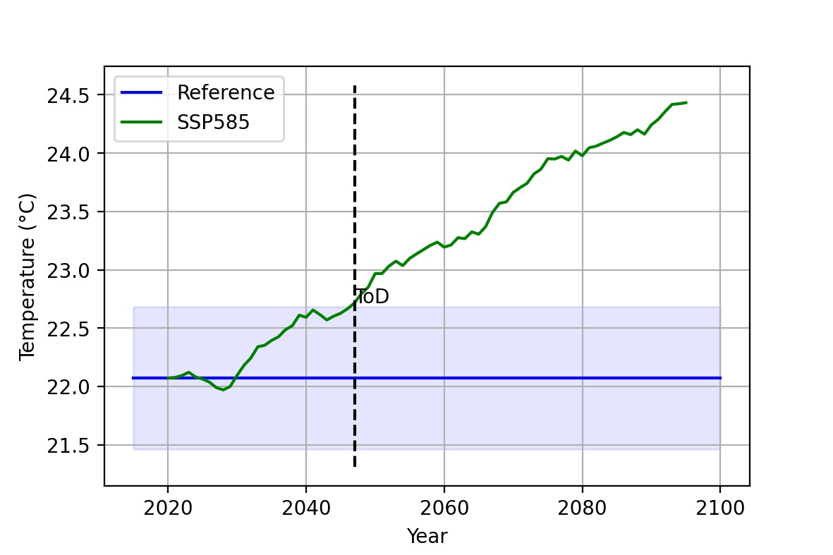
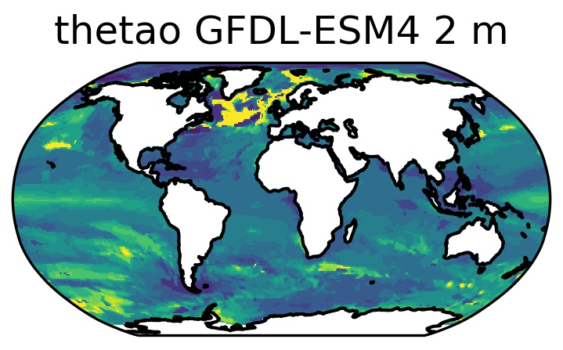
T2.4. Analysis of natural variability as a proxy for potential thresholds
10-yr smoothed projection
PiControl
interannual ±2σ

Slide 15
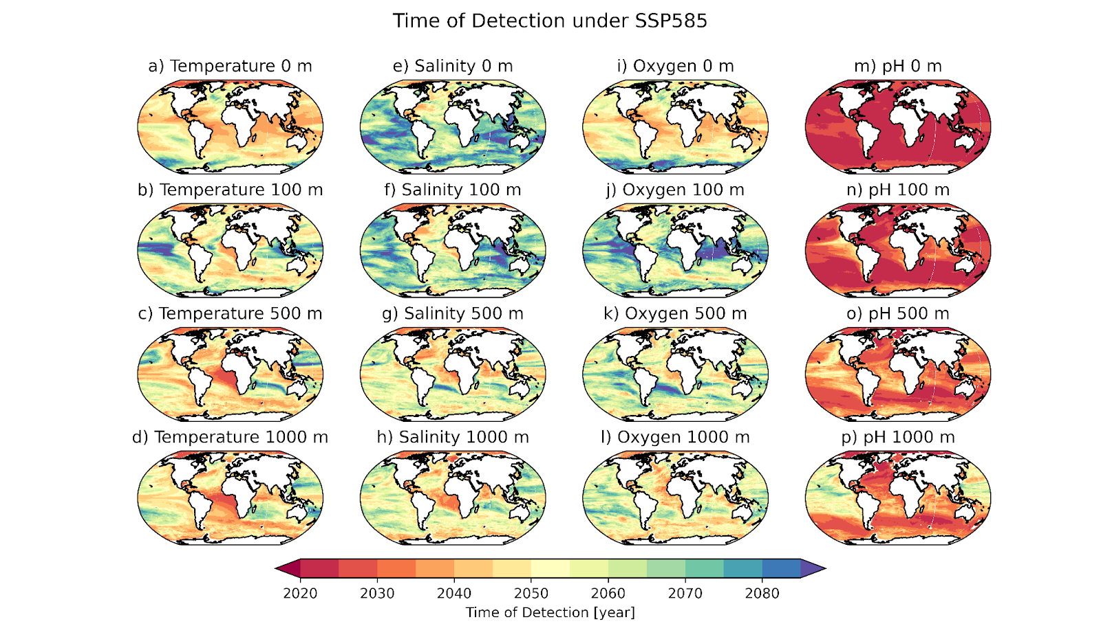
T2.4. Analysis of natural variability as a proxy for potential thresholds

Slide 16
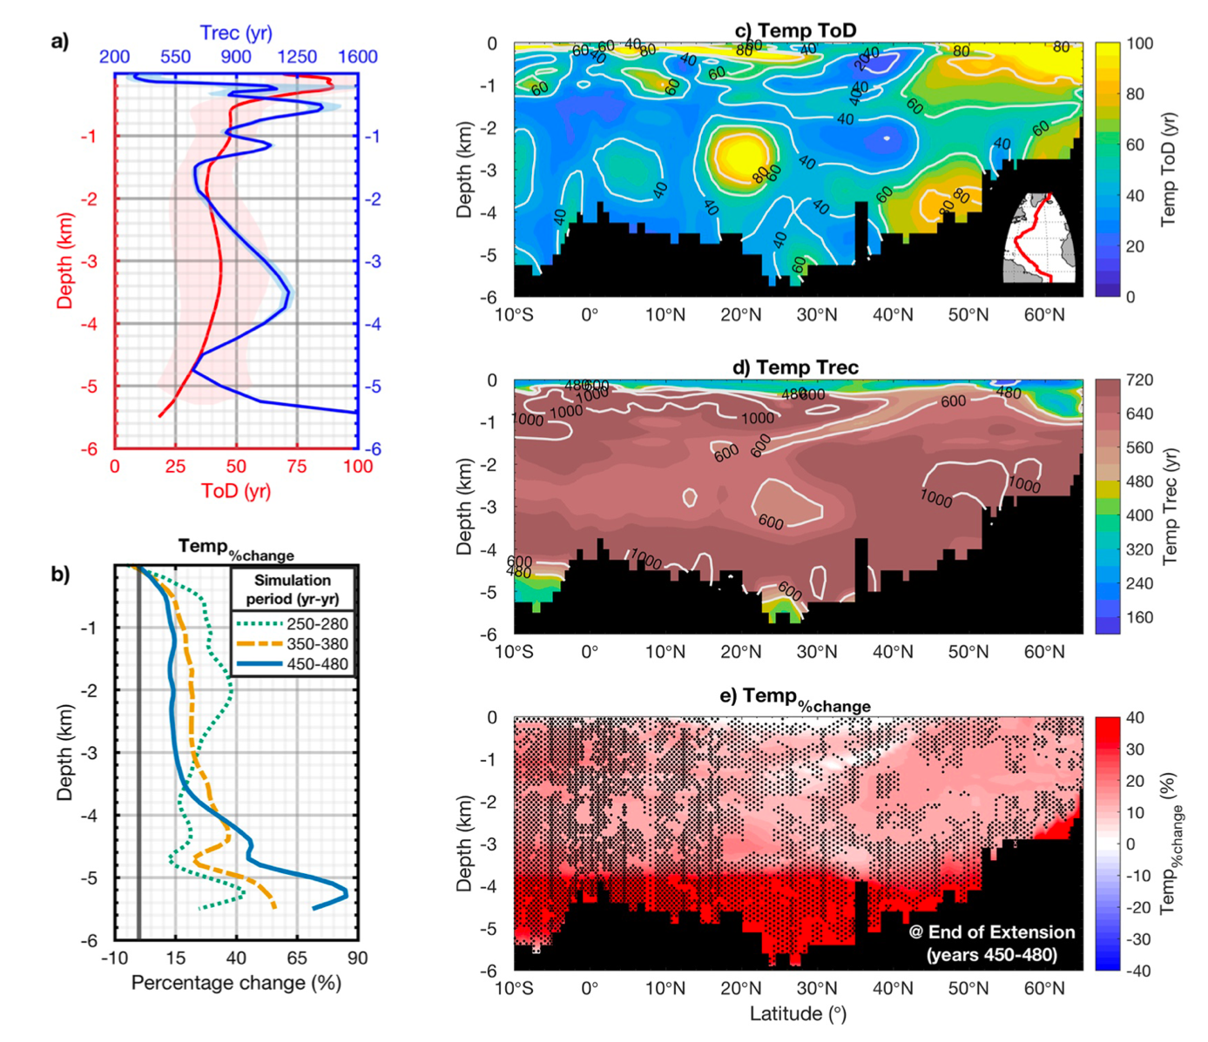
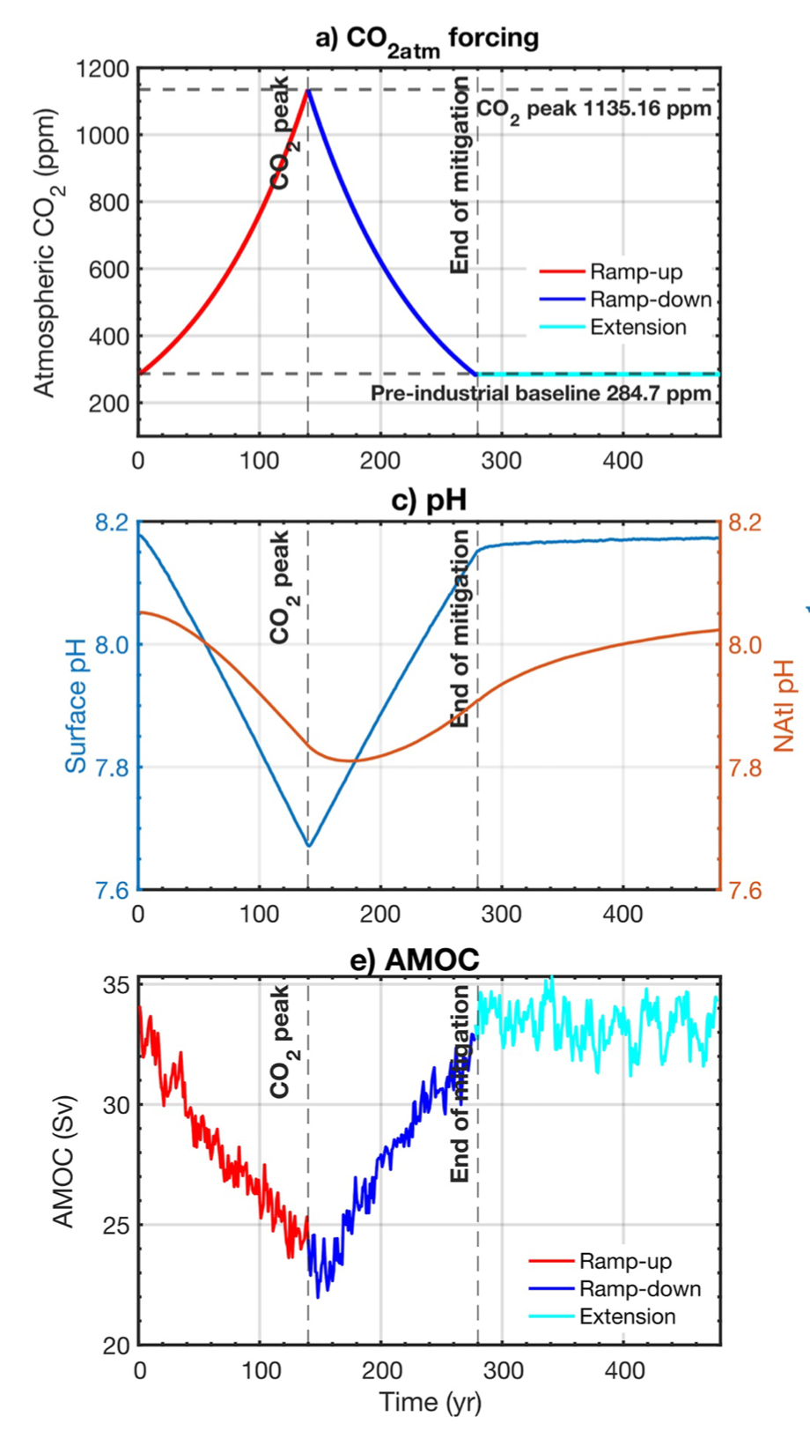
T2.4. Analysis of natural variability as a proxy for potential thresholds
Bertini and Tjiputra (2022)

Slide 17
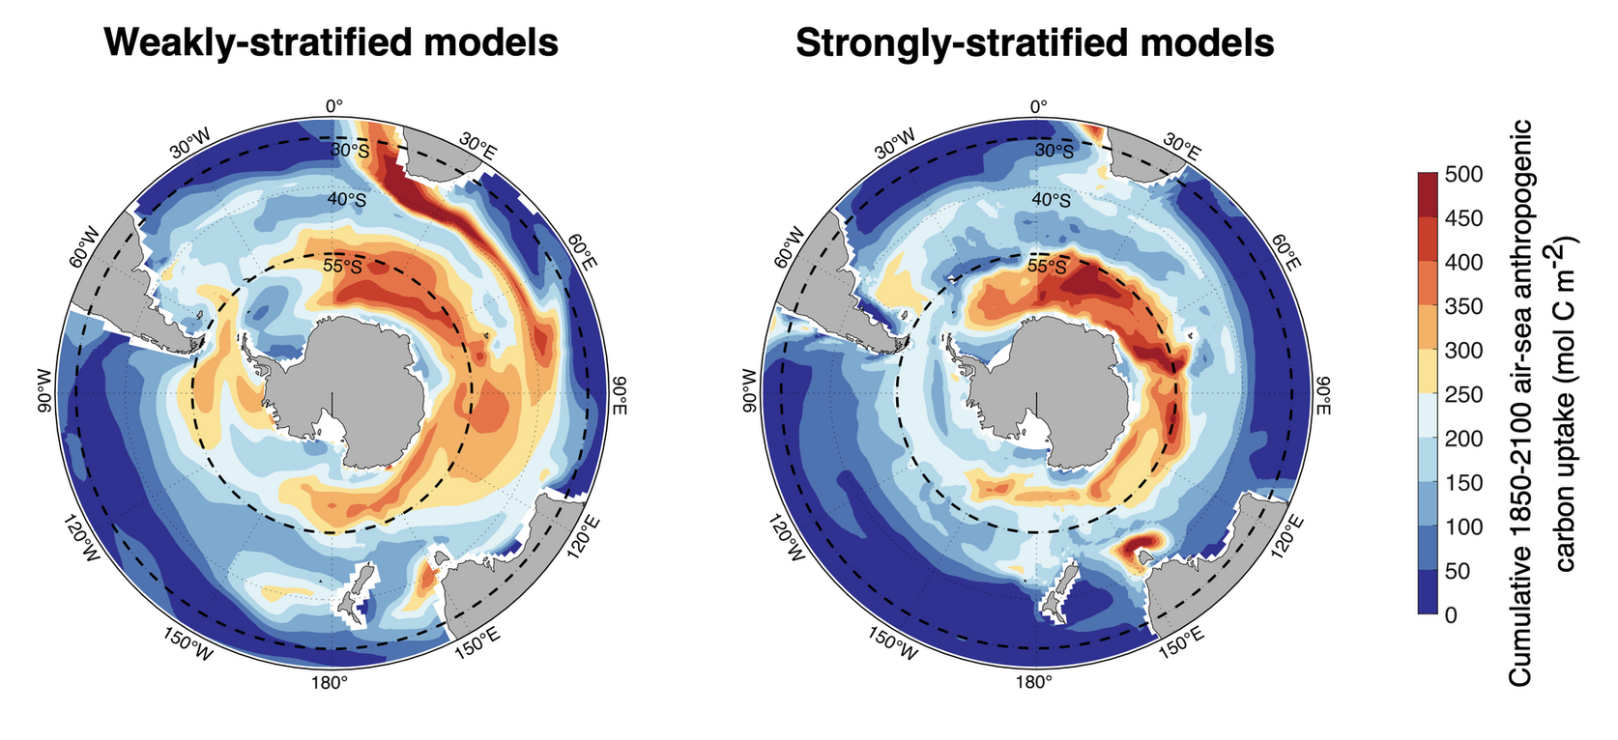
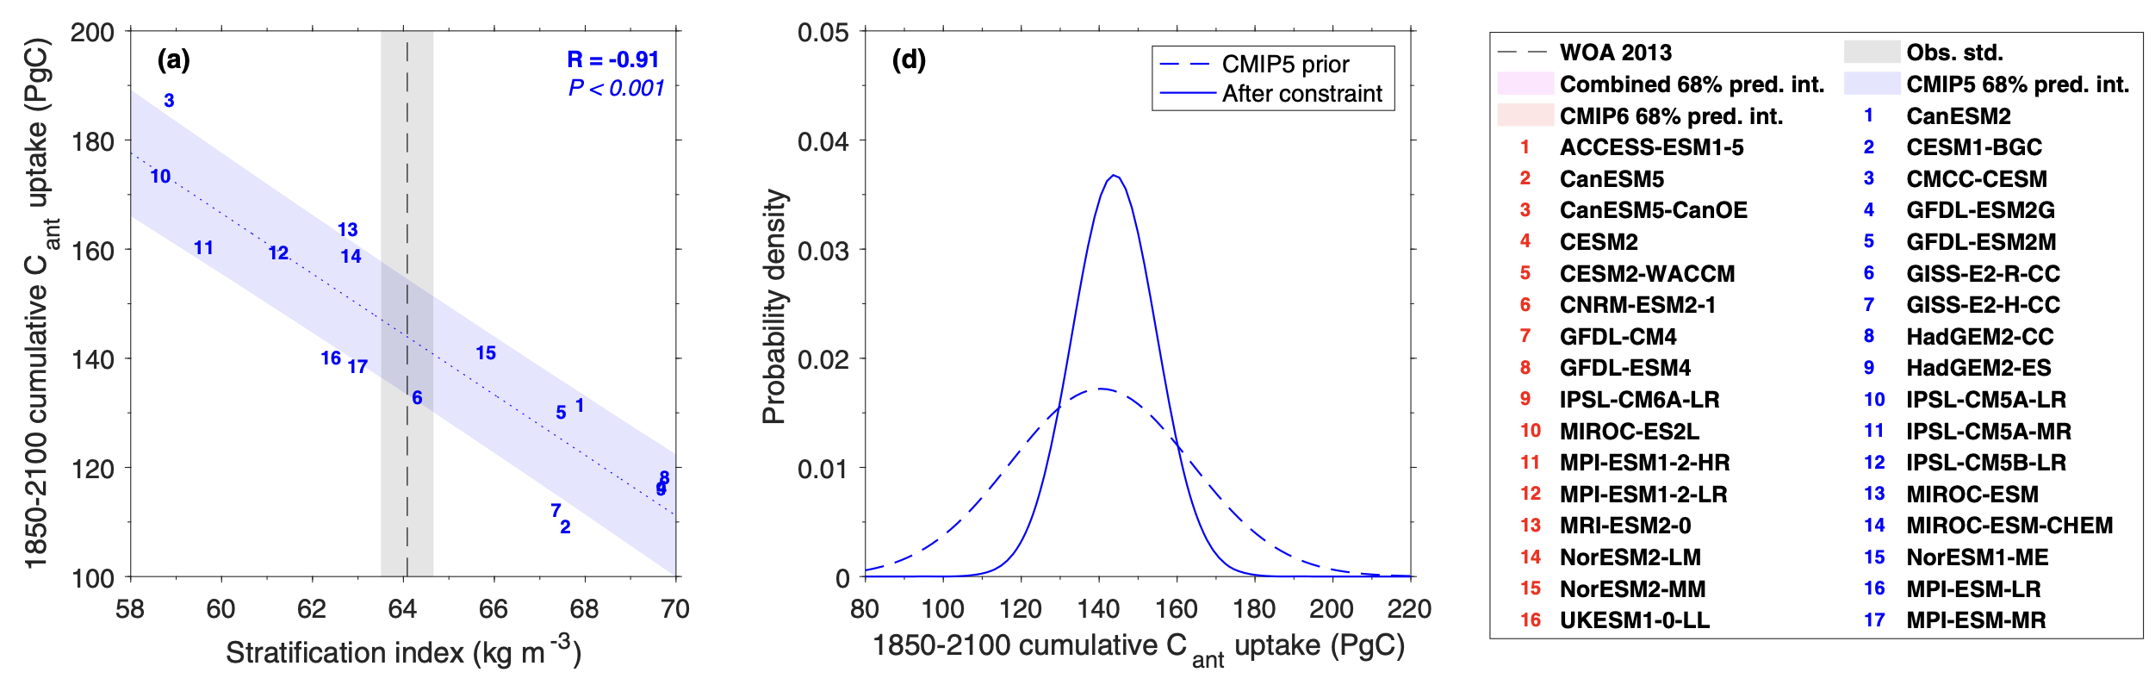
T2.5. Identify potential emergent constraints
Bourgeois et al. (2022)

Slide 18
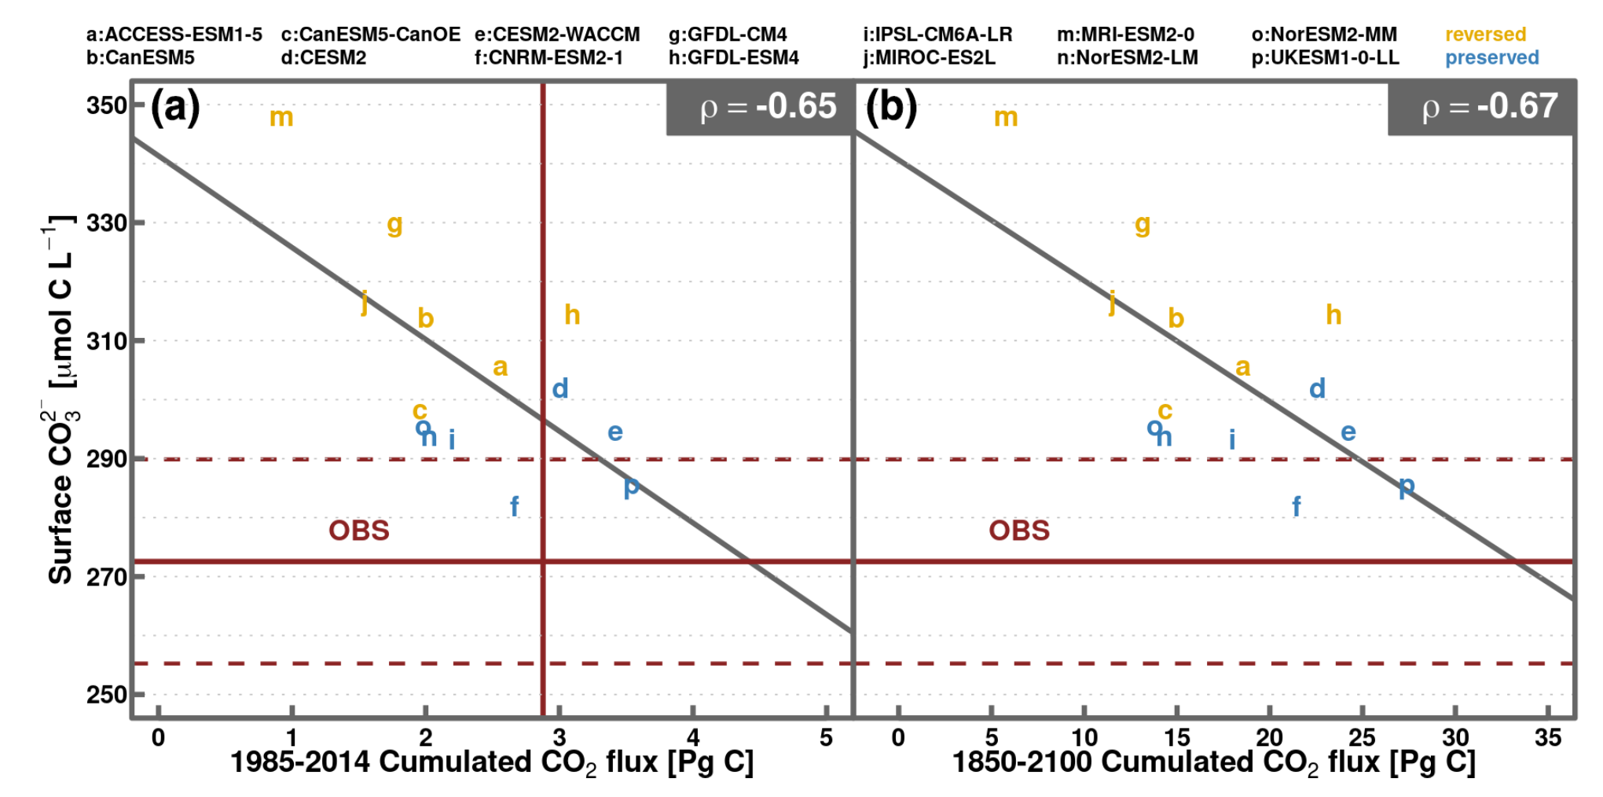
T2.5. Identify potential emergent constraints
Potential reversal of CO₂-ENSO relationship in Equatorial Pacific as projected in CMIP6
Pradeebane Vaittinada Ayar, Jerry Tjiputra NORCE, Norway
Present-day
Future
Vaittinada Ayar et al. (2022)

Slide 19
WP2 remaining tasks
T2.1. Assessment and prioritization of approaches to evaluate ESM skill
T2.2. Validation of ESMs at regional and coastal levels
T2.3. Benchmark for each regional system from ESM projection data
T2.4. Analysis of natural variability as a proxy for potential thresholds
T2.5. Identify potential emergent constraints
T2.6. Identify large-scale patterns and teleconnections with impacts on regional scales

Slide 20
Summary
Deliverables and milestones are on track.
Focus for next year will be on:
Finalizing publication on time of emergence using ESM outputs.
Analyzing impact of AMOC on North Atlantic biogeochemistry.
ENSO extreme impacts on CO2 fluxes.
Contributing to WP3 in assessing the added values of regional downscaling.
Consider synthesis paper (WP3) on value of regional downscaling on projecting environmental changes key for marine services:
MHW, compound extreme (warming, deoxygenation, acidification), thermal range, interior ventilation (deoxygenation), tipping points, basin scale multiple stressor analysis, AGI, Julian’s SDM, etc.

Slide 21
T2.6. Identify large-scale patterns and teleconnections with impacts on regional scales
Ivan Almendra, Julia Ruiz Girona, Veronique Garcon, and Boris Dewitte
LEGOS, France and CEAZA, Chile

Slide 22
T2.6. Identify large-scale patterns and teleconnections with impacts on regional scales
Potential reversal of CO₂-ENSO relationship in Equatorial Pacific as projected in CMIP6
Pradeebane Vaittinada Ayar, Jerry Tjiputra NORCE, Norway
Present-day Future Observation

Slide 23
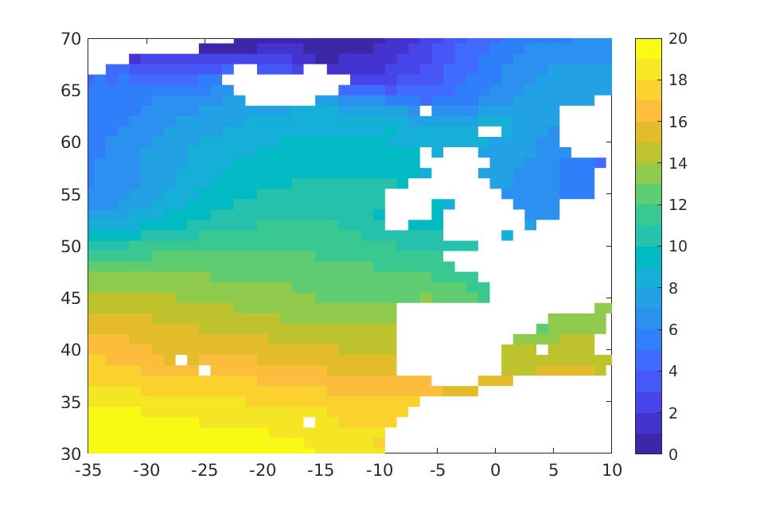
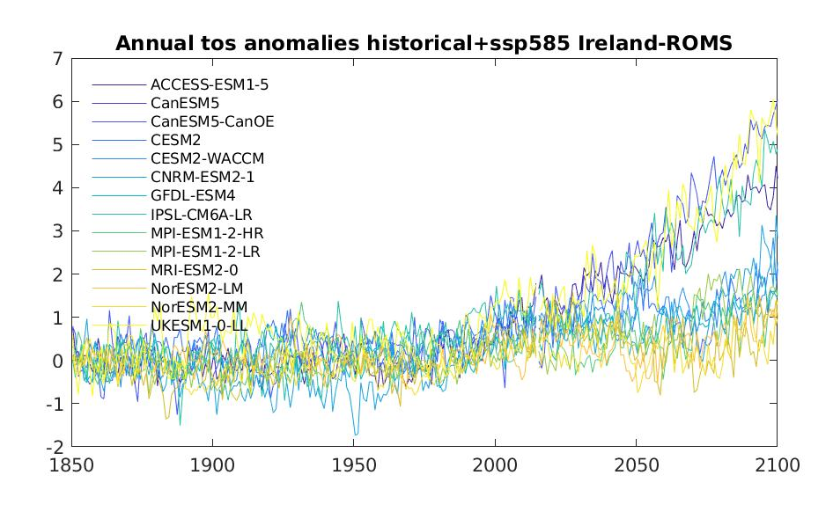
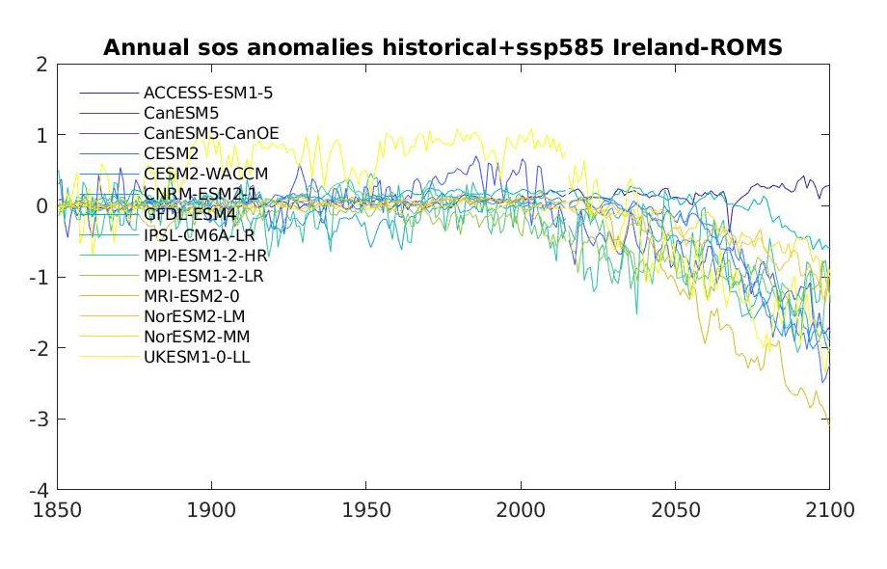
T2.3. Benchmark for each regional system from ESM projection data T2.4. Analysis of natural variability as a proxy for potential thresholds
Southern Ireland domain
Jerry Tjiputra, Momme Butenschon, Rachel Cave
NORCE, Norway; CMCC, Italy; NUI, Ireland
Surface temperature anomalies
Surface salinity anomalies

