Slide 1

Avoiding temperature overshoot by deploying stratospheric aerosol injection
Jerry Tjiputra

Slide 2
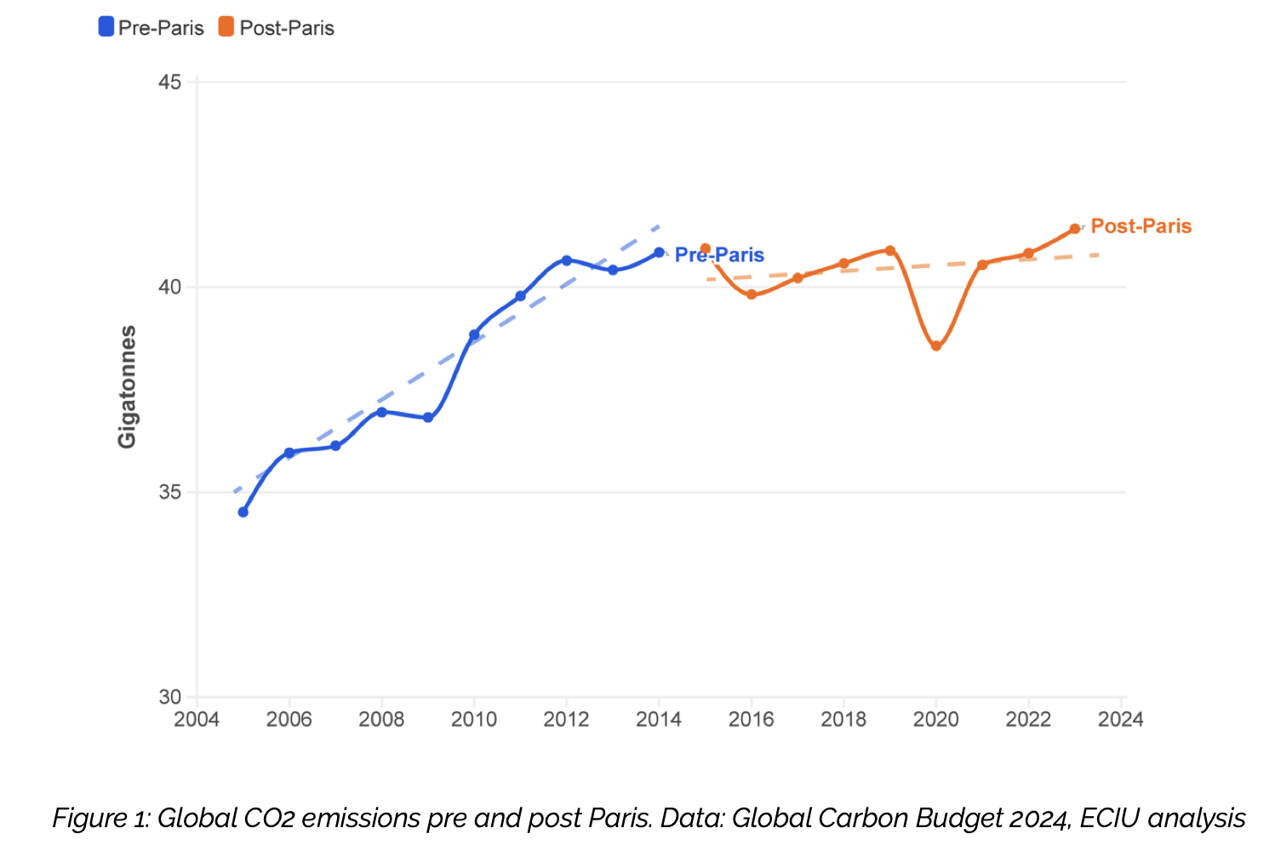
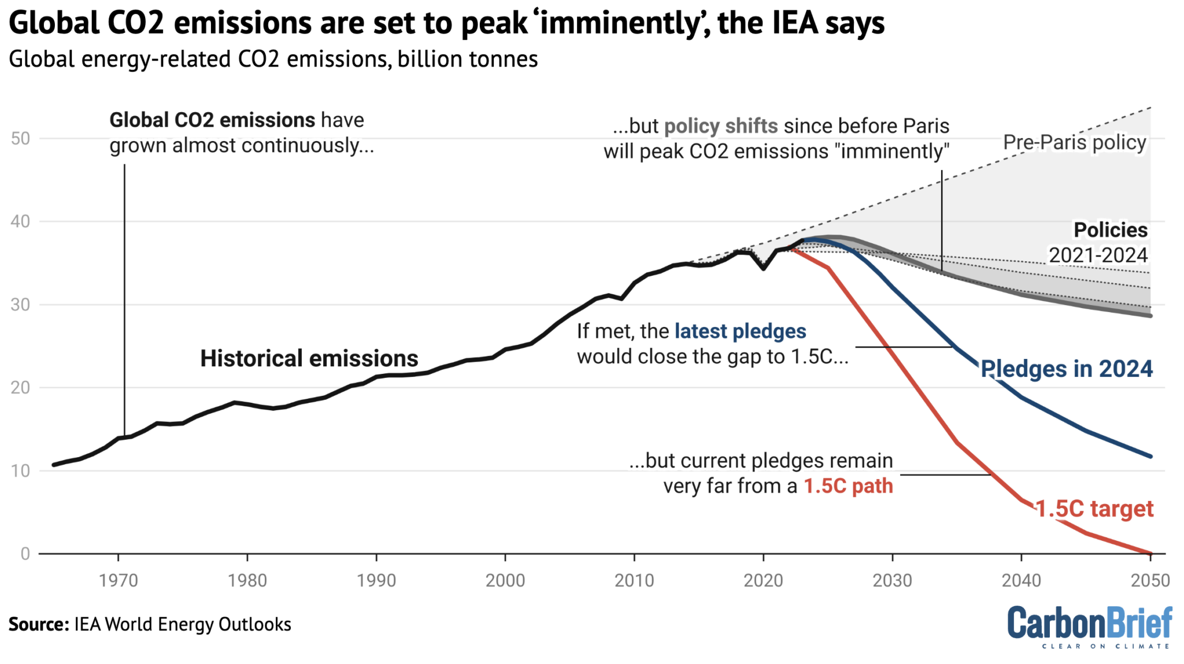
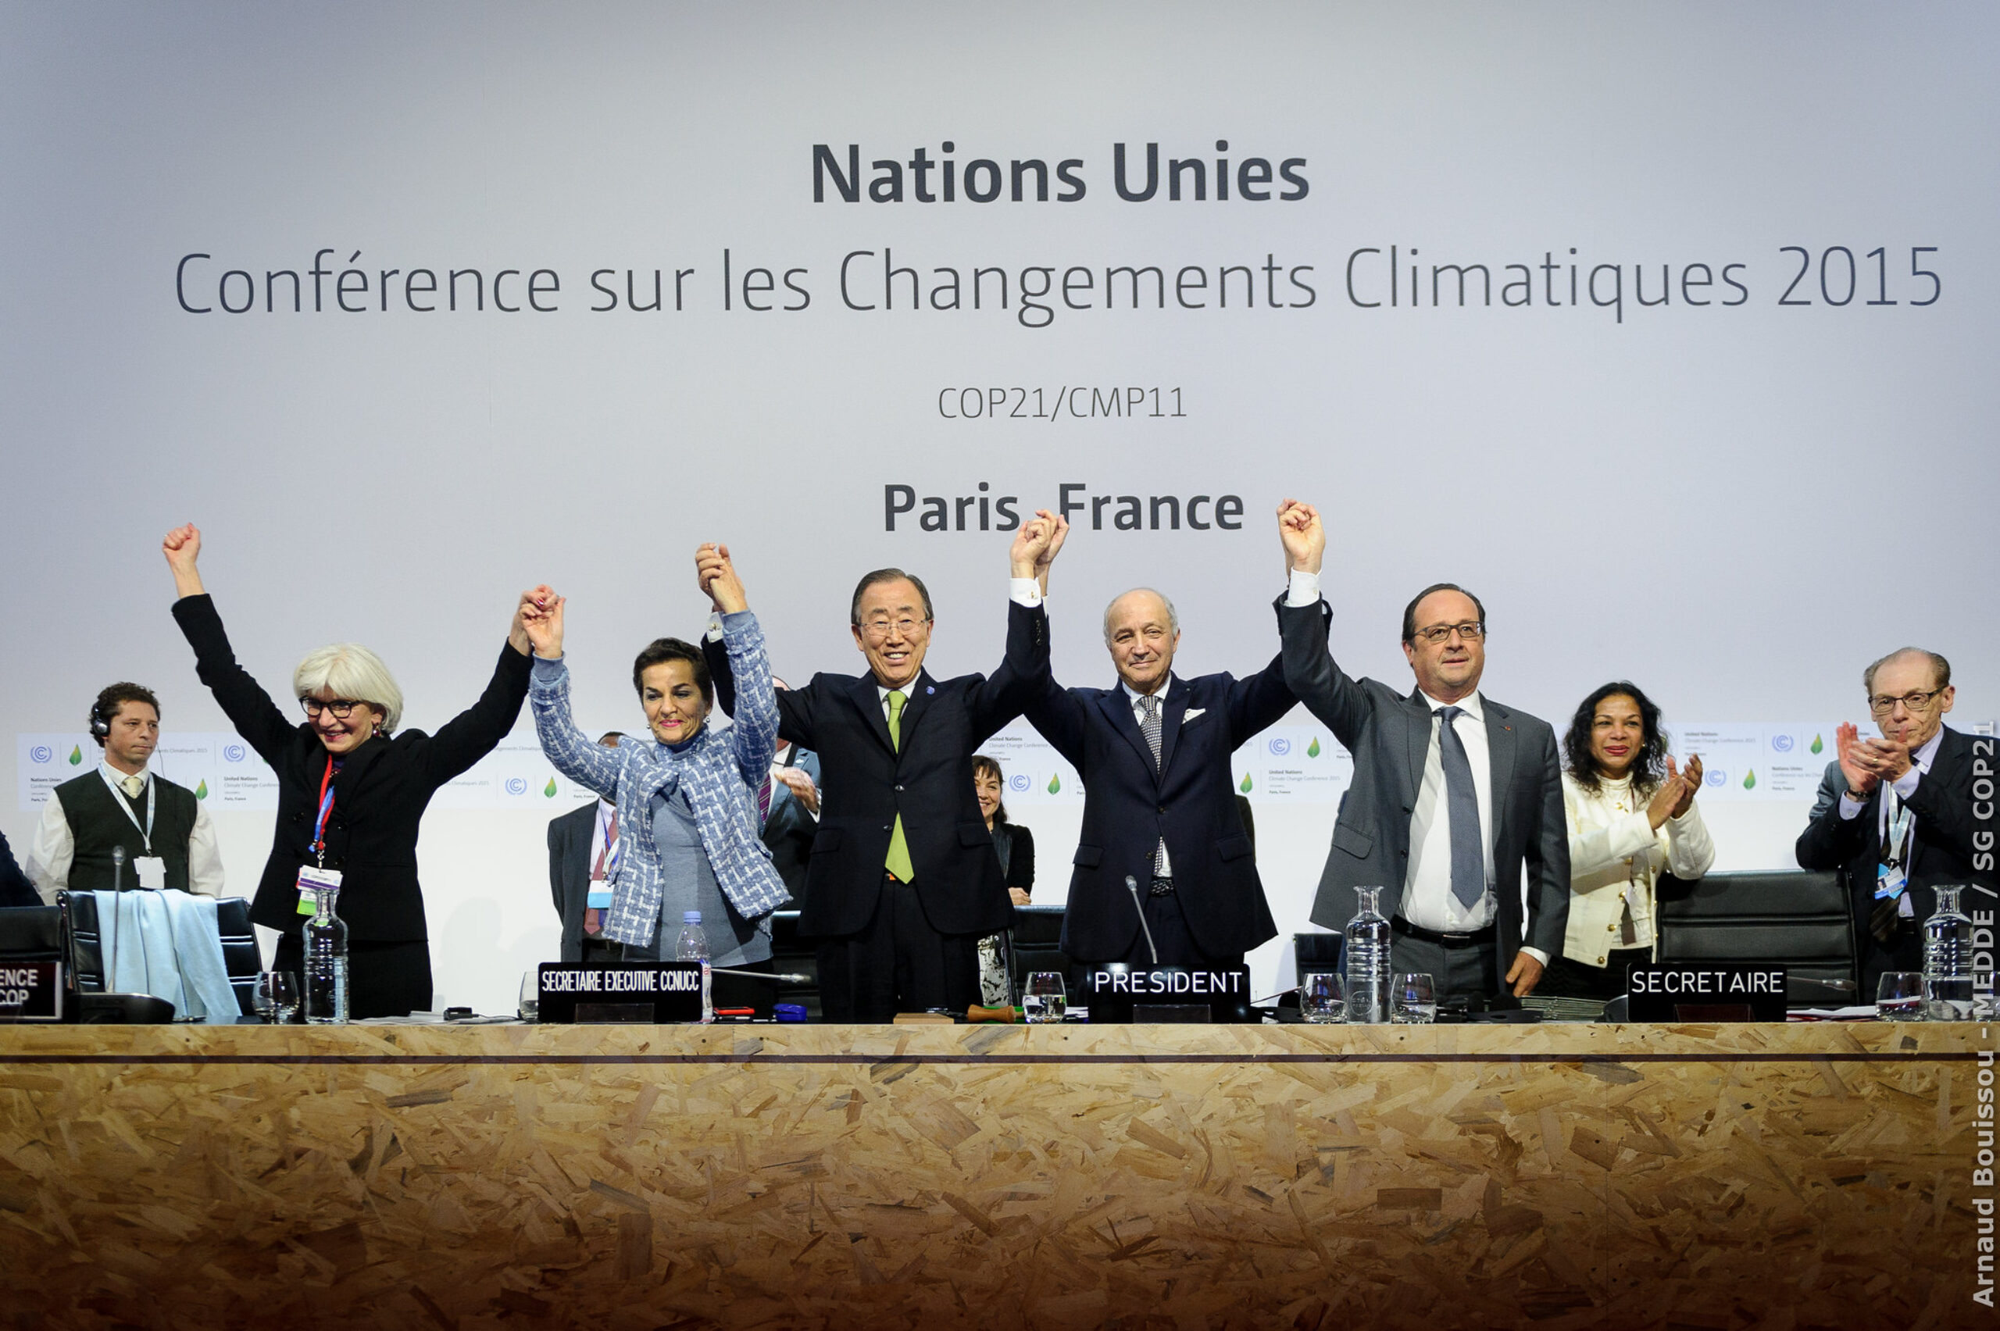
CO₂ emisions

Slide 3

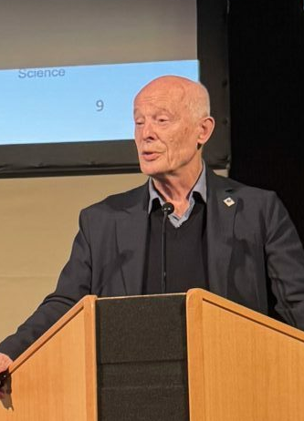


Laxenburg, October 2025
“
1.5° is dead
2.0° is agony
3.0° is looming.
”
- Prof John Schellnhuber
Director General, IIASA
ATLAS25
Helsinki, November 2025
“
Global warming will exceed 2 degree.
”
- Dr James Hansen
Columbia University

Slide 4
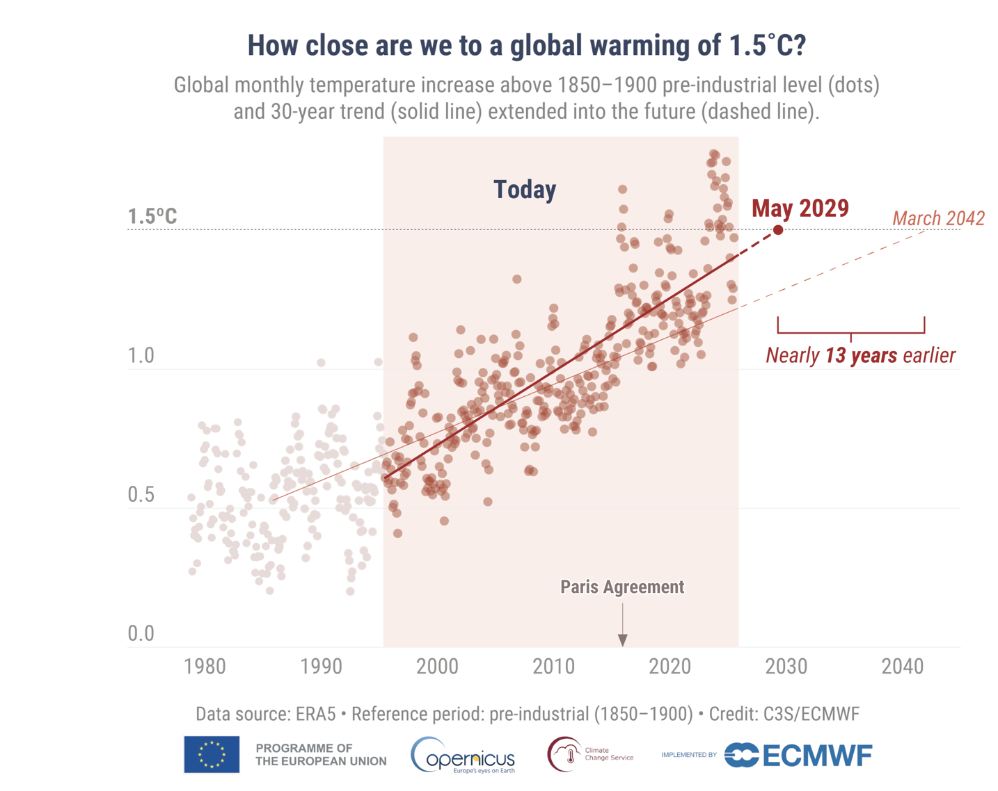

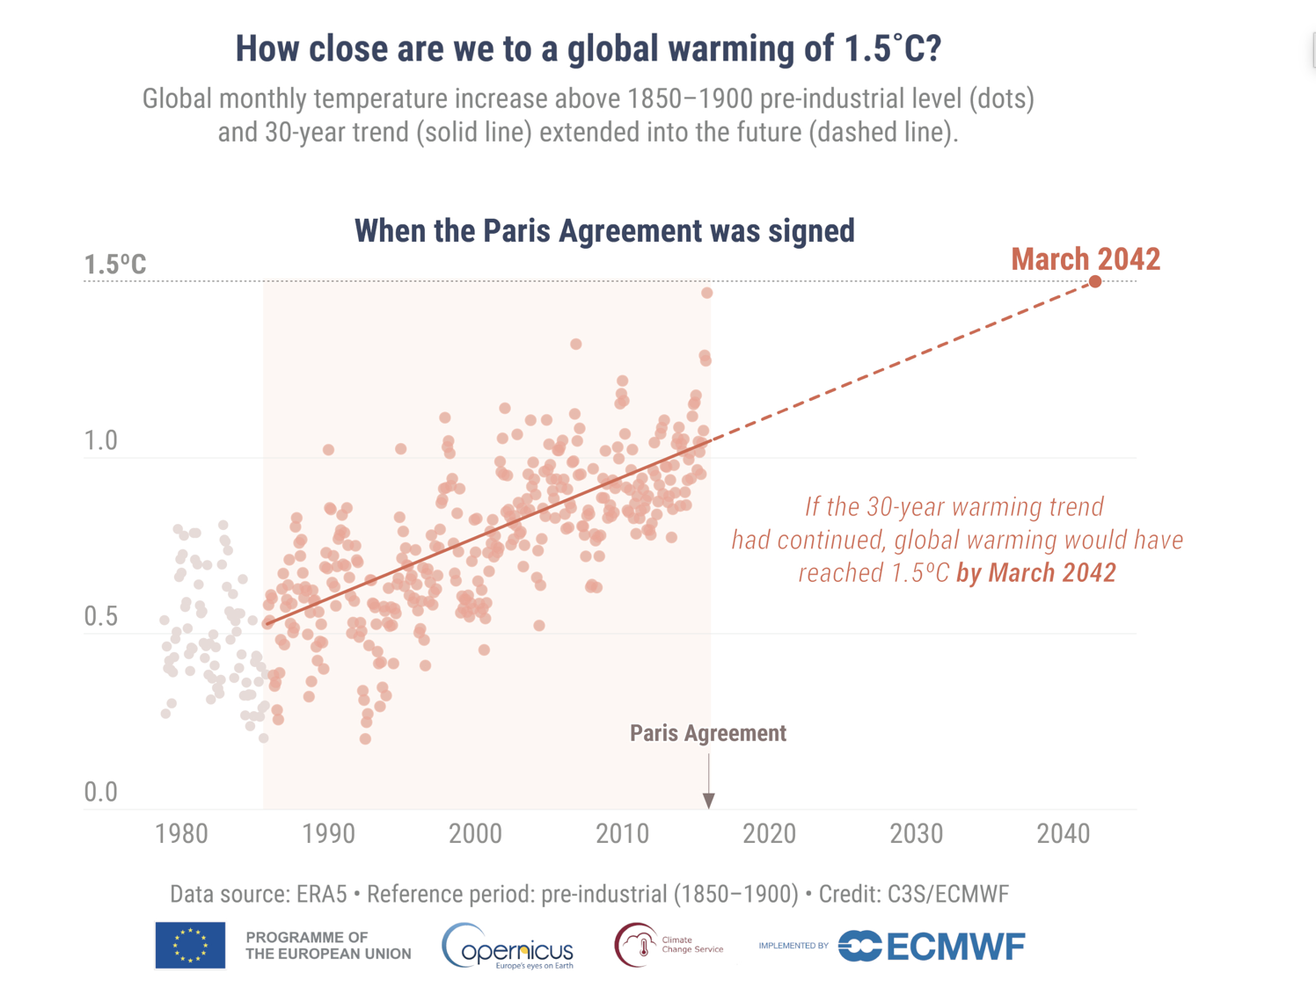
https://climate.copernicus.eu/

Slide 5
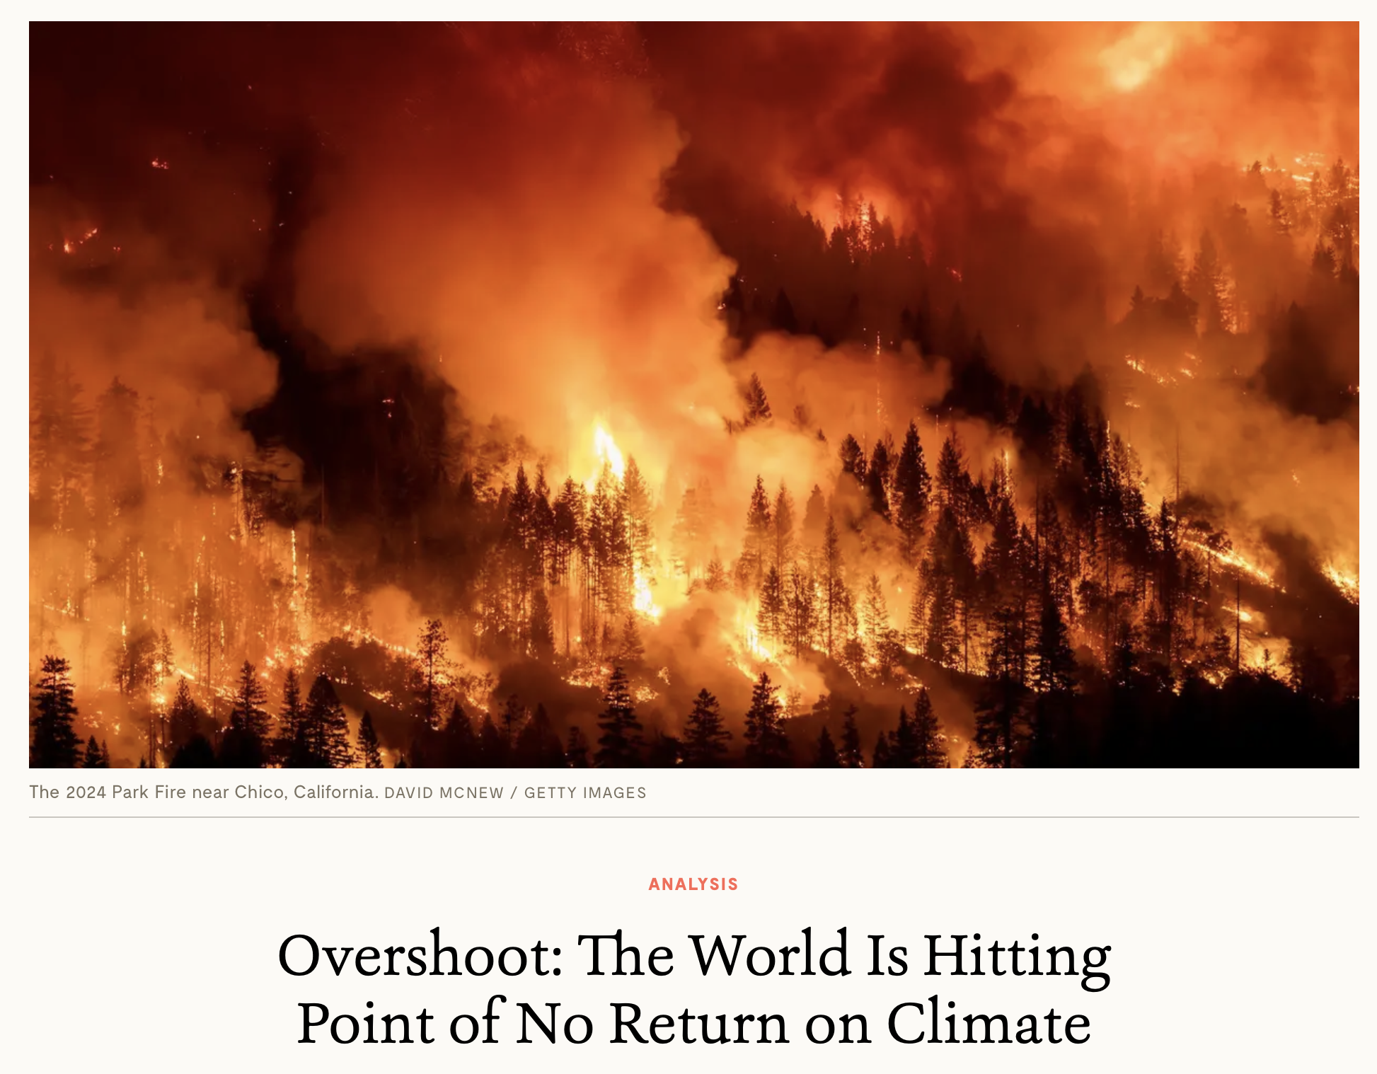

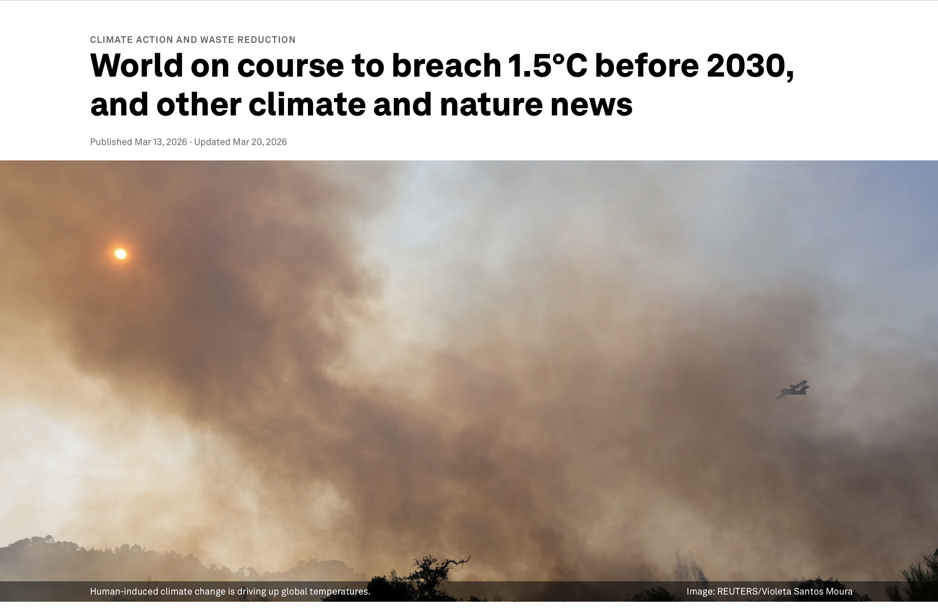
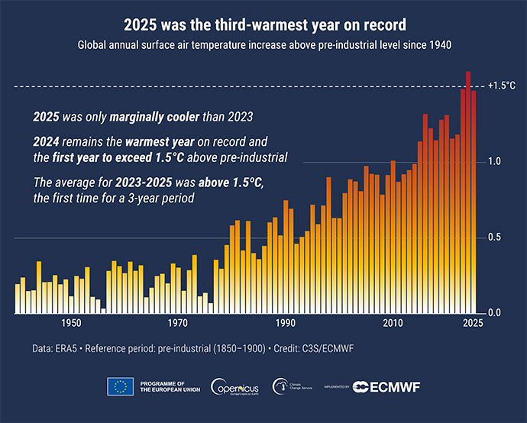

Slide 6
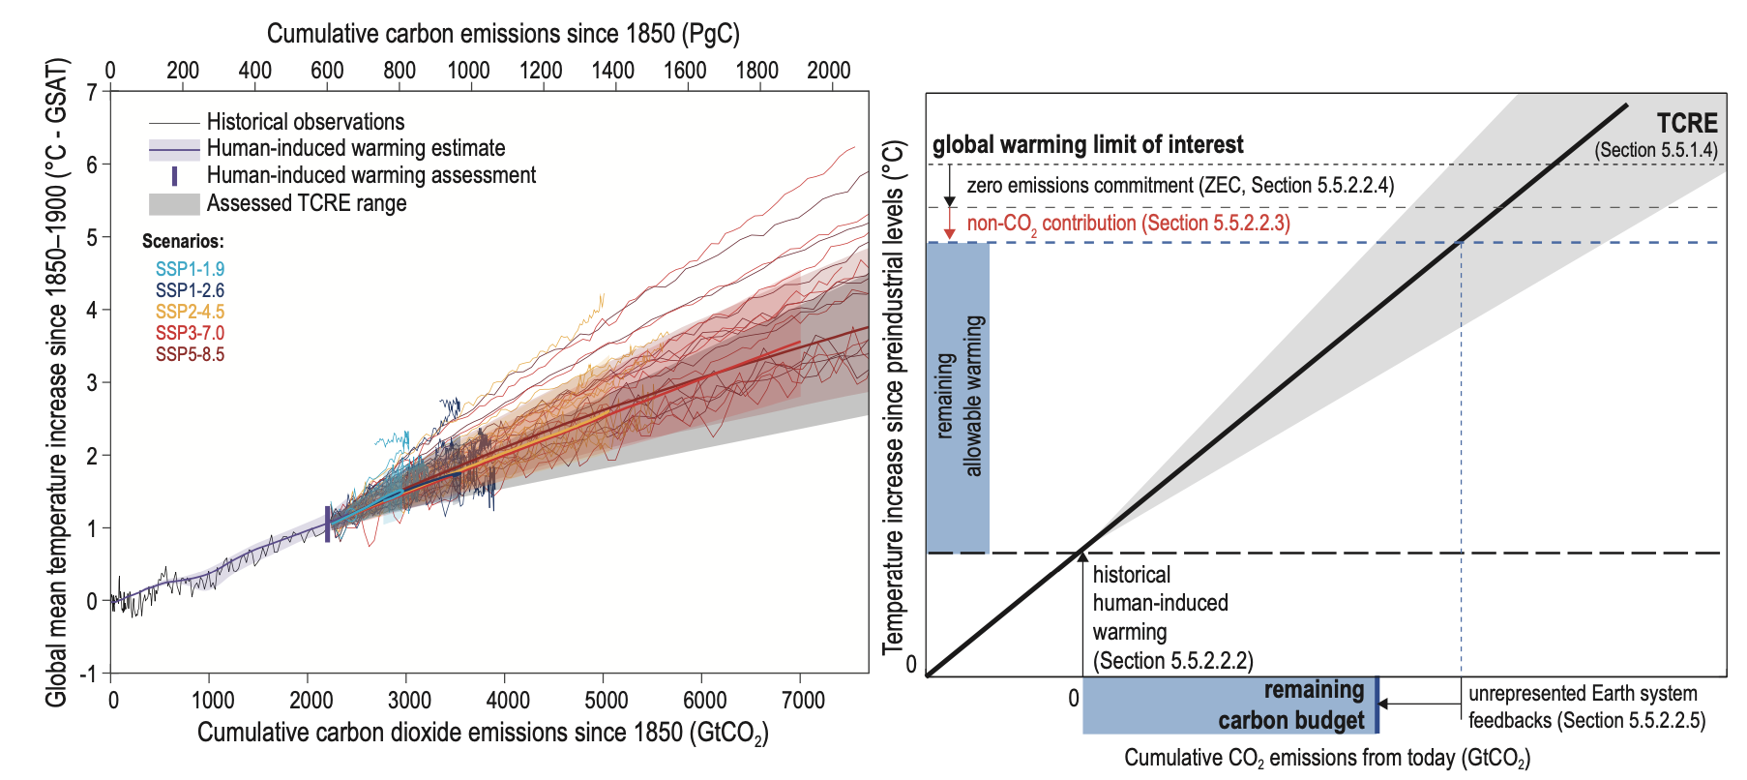
2730 ± 240 GtCO₂
(Friedlingstein et al., 2026)
IPCC-AR6 Ch5

Slide 7
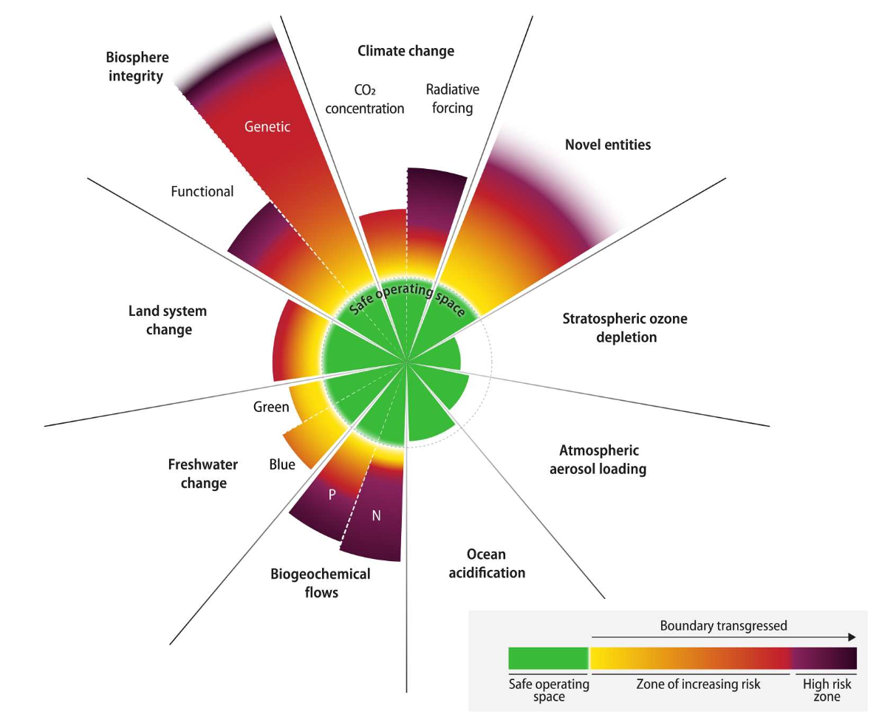
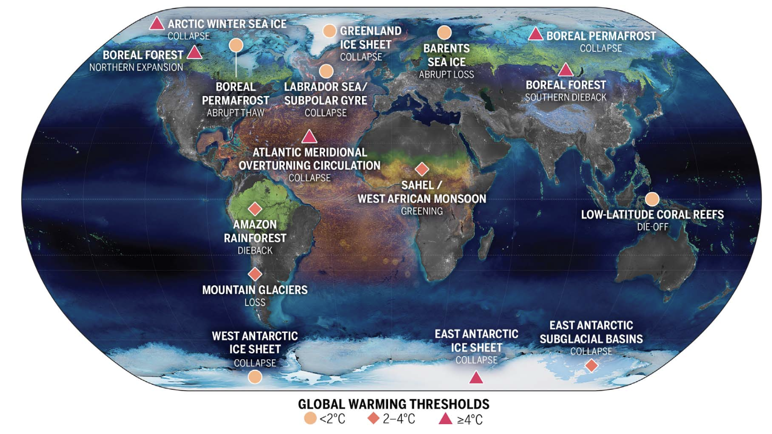
Overshoot matters
Armstrong McKay et al. (2022); Richardson et al. (2023)

Slide 8
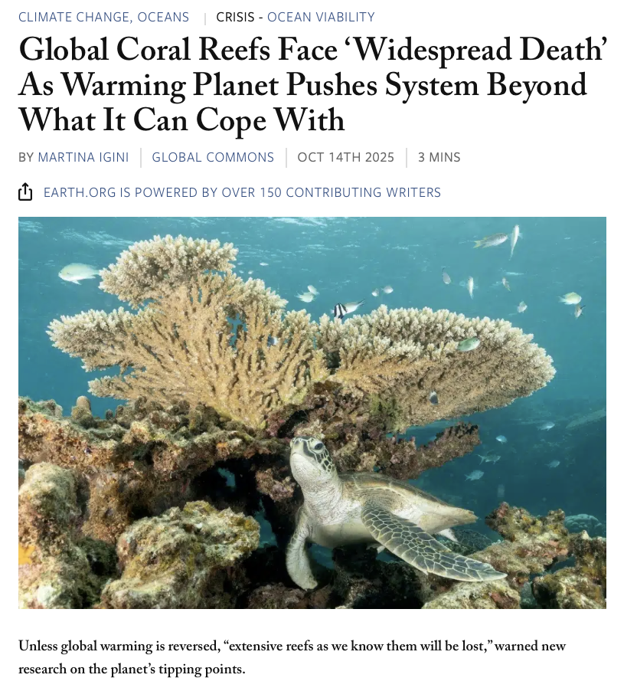
Earth.org

Slide 9
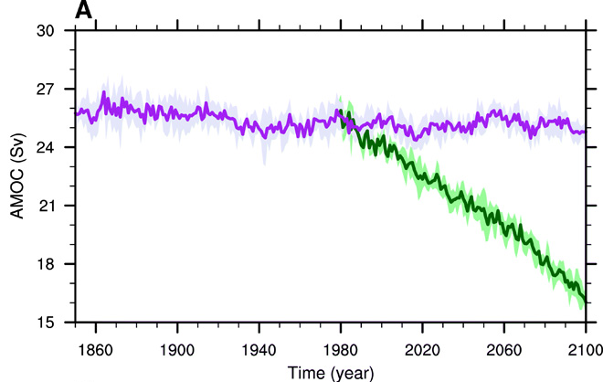
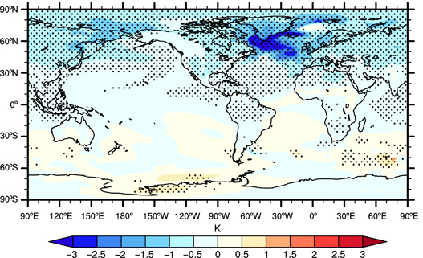
AMOC
CESM1
∆TAS due to AMOC weakening
Drijfhout et al. (2025); Liu et al. (2020)

Slide 10
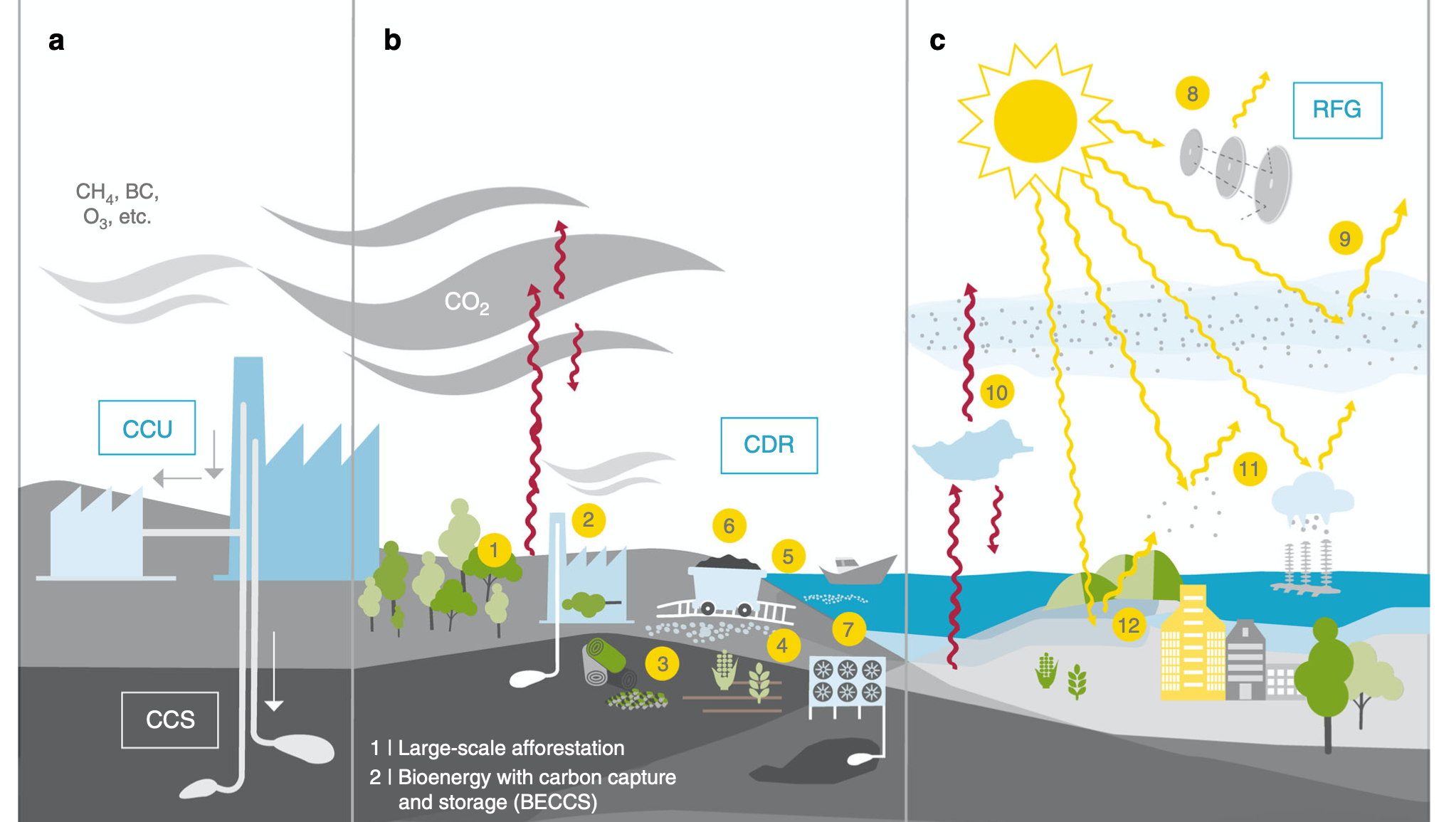
Geoengineering
Lawrence et al. (2018)

Slide 11
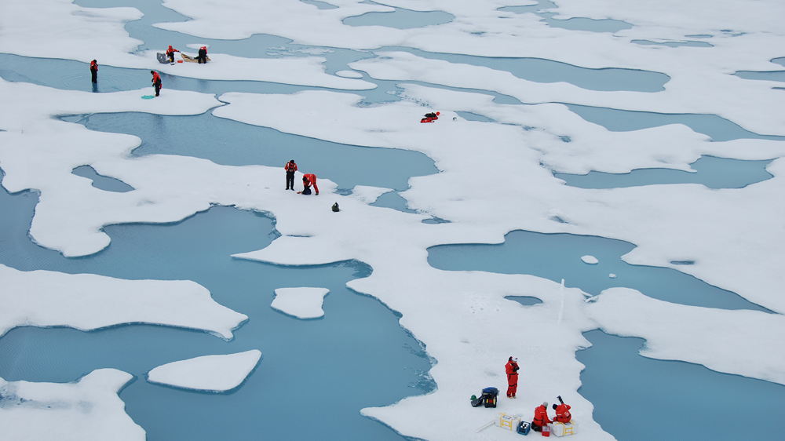
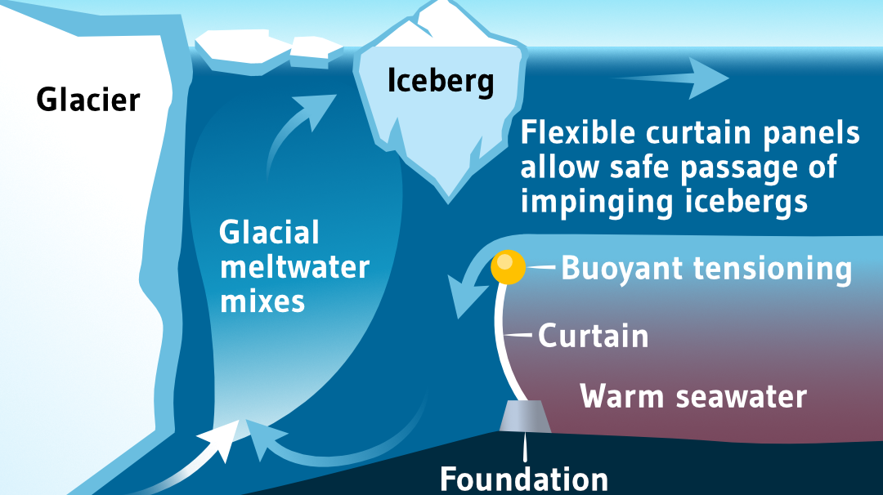
Other types of geoengineering
Pumping seawater from below sea-ice to enhance formation
Seabed curtain to slow down glacial melting
© Melinda Webster
© Marianne Hagen

Slide 12

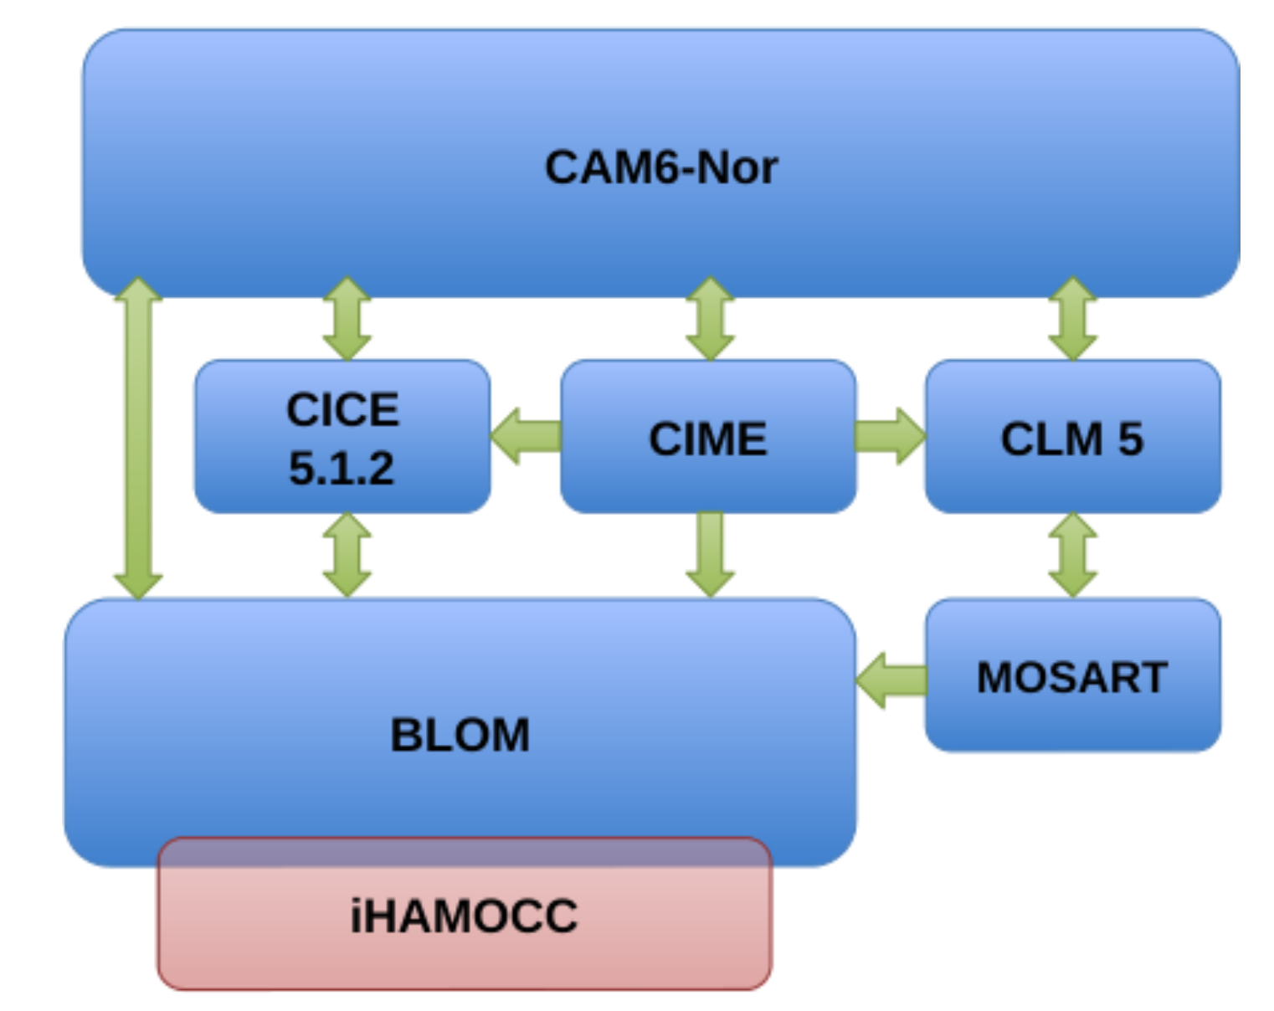
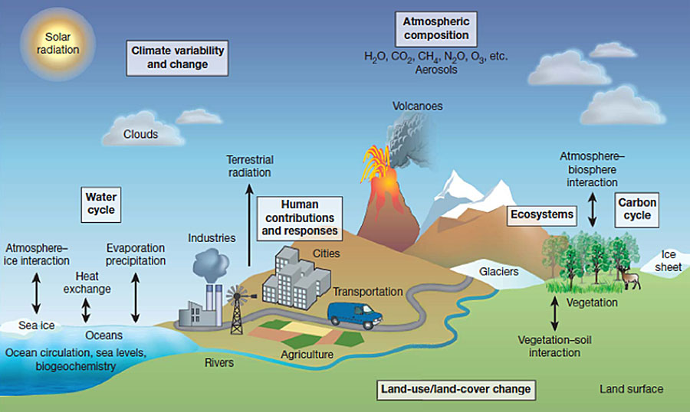
Norwegian Earth System Model
Atmosphere
Land
Ocean
Rivers
Seland et al. (2020); Tjiputra et al. (2020)

Slide 13
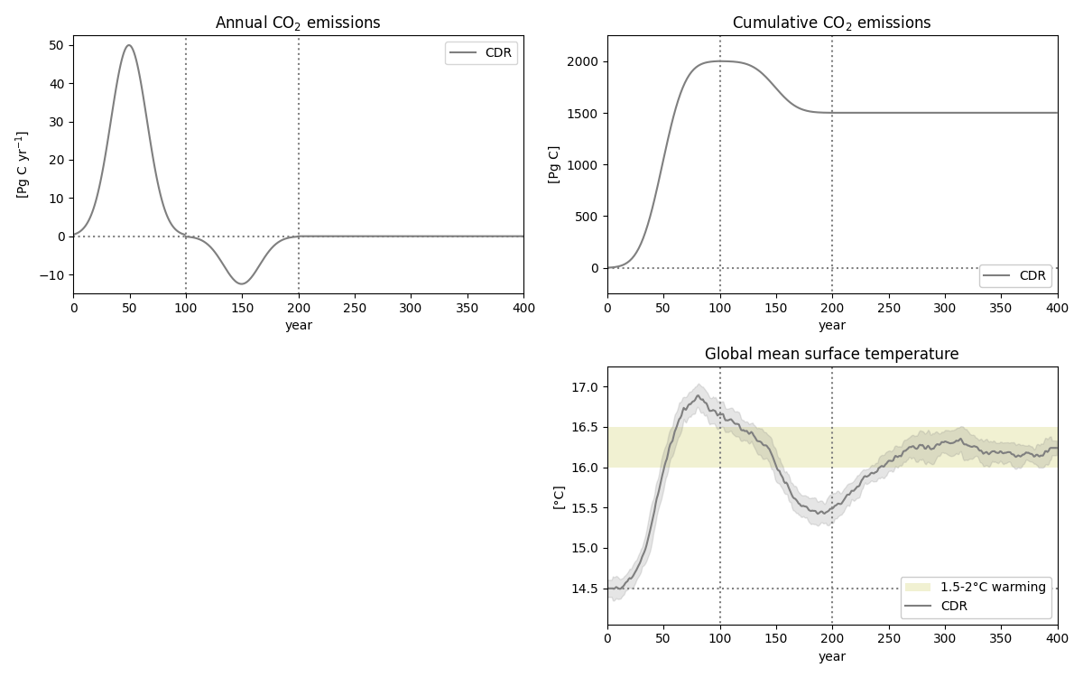
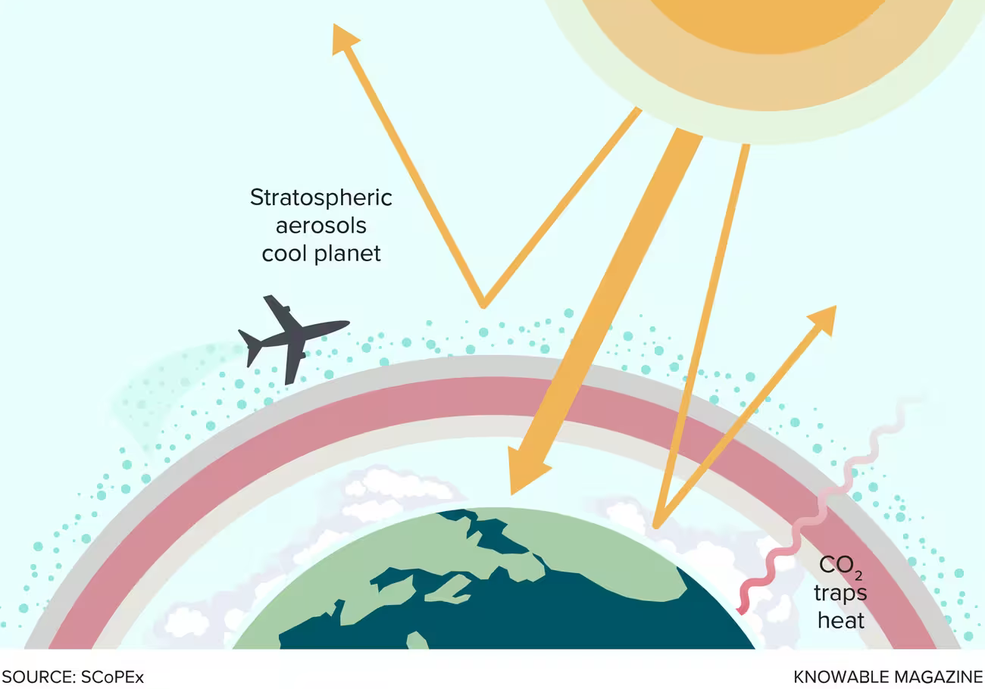
NorESM idealized scenarios
CDR

Slide 14
NorESM idealized scenarios
CDR

Slide 15
NorESM stratospheric aerosol injection

Slide 16
NorESM stratospheric aerosol injection

Slide 17
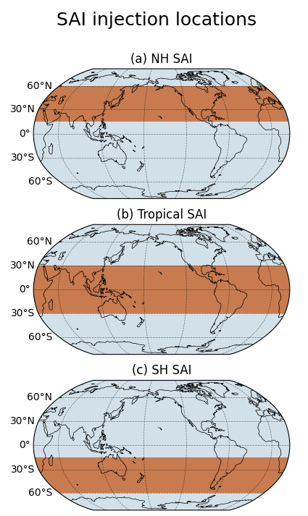
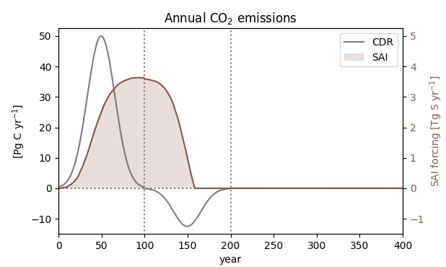
NorESM idealized scenarios
15°N-60°N
30°S-30°N
15°S-60°S

Slide 18
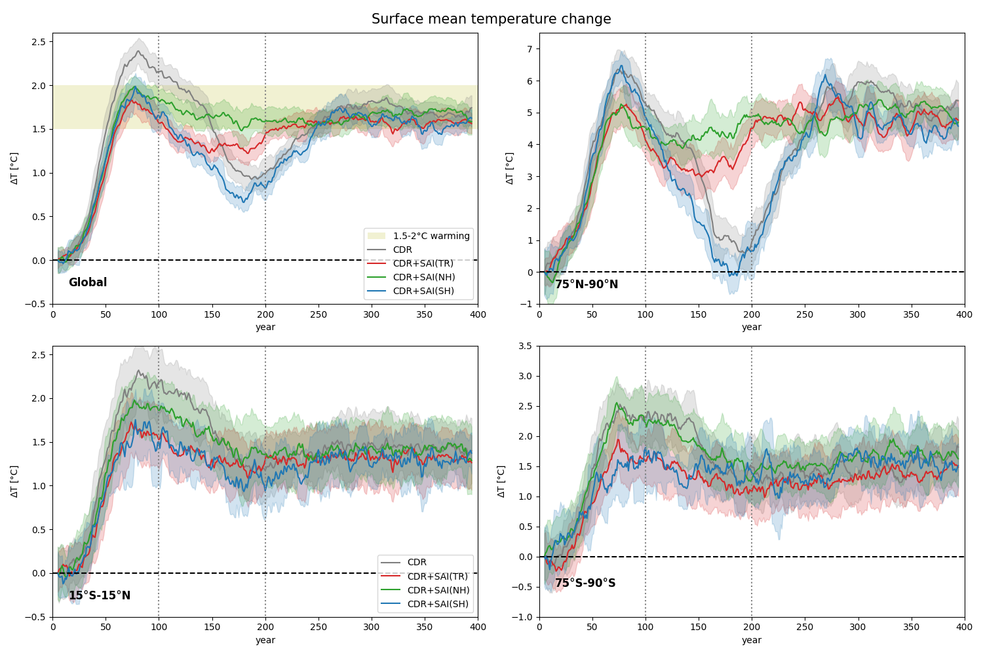
Global mean temperature

Slide 19
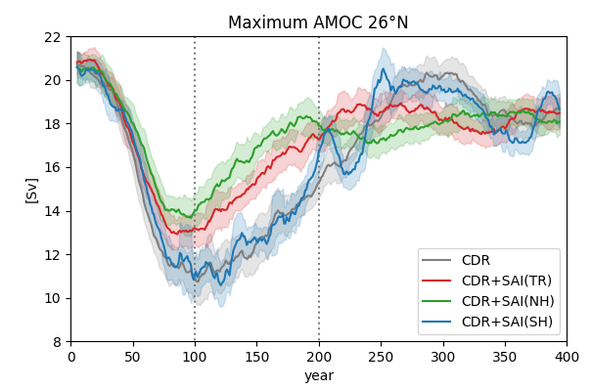
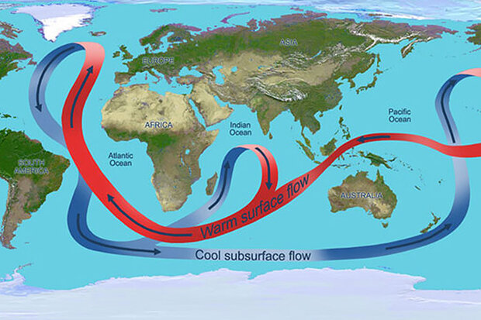
Global, polar and tropical mean temperature

Slide 20
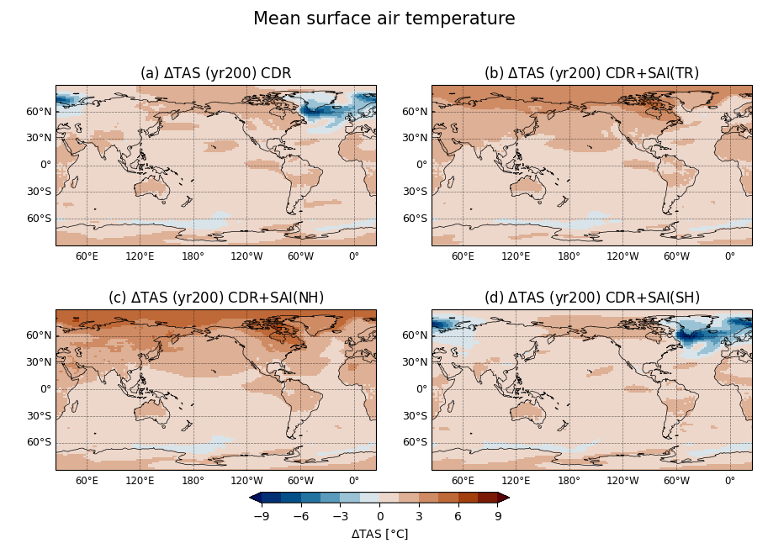
Spatially heterogeneous mean temperature at the end of climate interventions
No SAI
SAI - TR
Global mean ∆surface temperature
SAI - NH
SAI - SH

Slide 21
AMOC freshwater feedback

Slide 22
Sea-ice

Slide 23
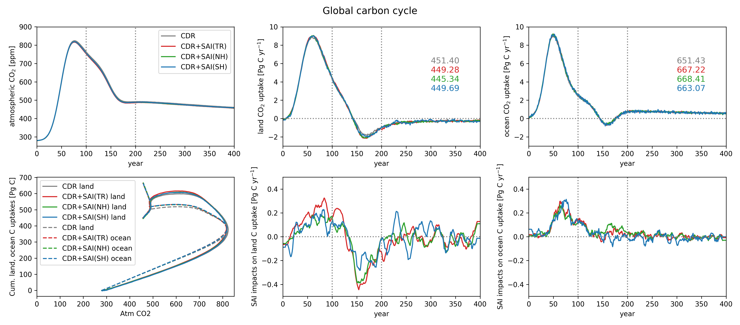
Global carbon cycle
During CDR, land and ocean C sink rates decrease with the land starting to outgass as atmospheric decline accelerates (yr 150), and continue towards the end of the simulation, whereas ocean only outgasses temporarily before starting to take up CO₂ again.

Slide 24
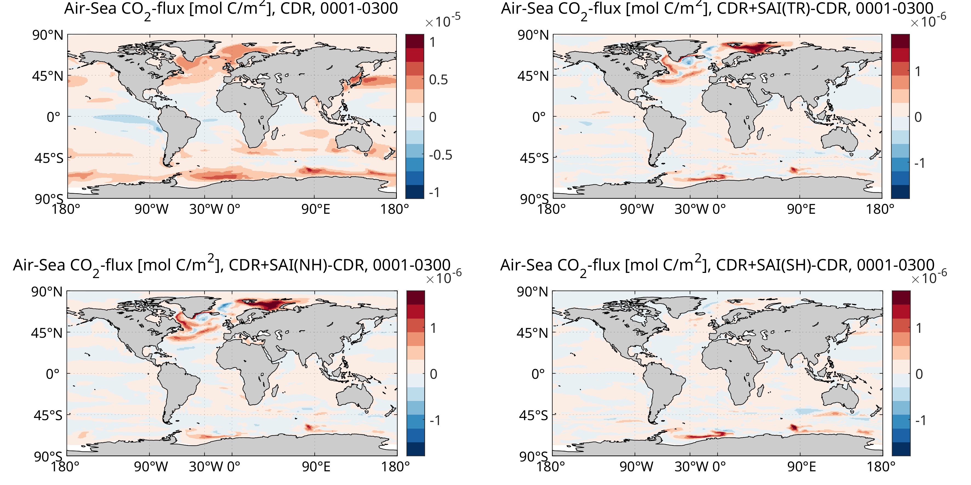
Ocean carbon sinks
Ocean CO₂-uptake [mol C/m²] yrs 1-300 w/ CDR
Sea-Air CO₂-flux [Pg/yr]
Cumulatively: >650Pg C
Additional CO₂-uptake [mol C/m²] w/ SAI (NH)
x10⁻⁶

Slide 25
Ocean acidification

Slide 26
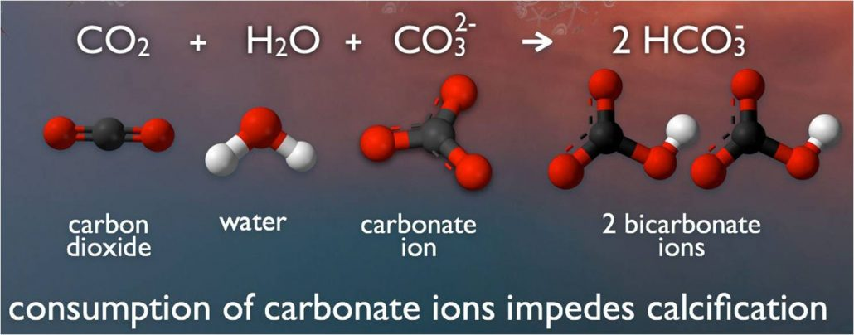
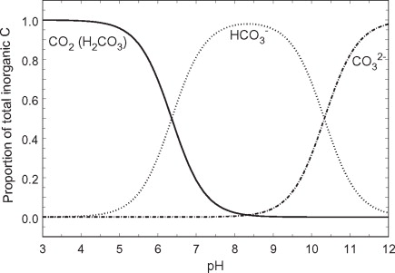
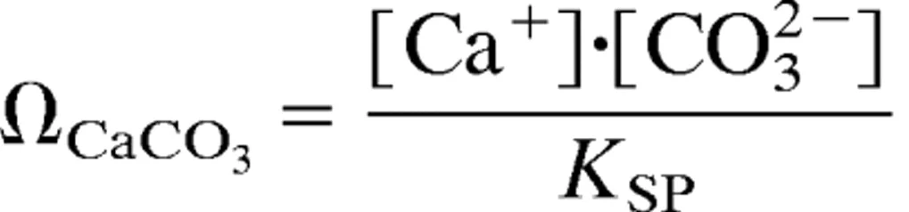
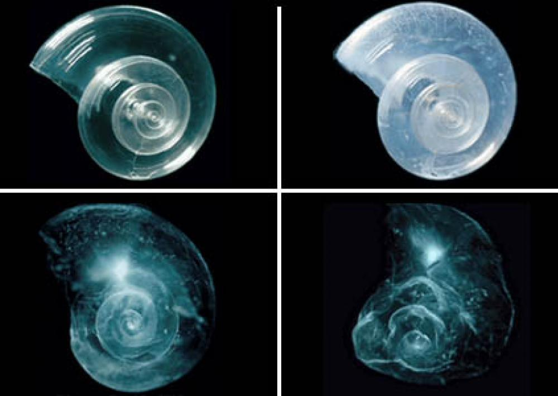
Ocean acidification
Dissolved inorganic carbon in seawater
Ca²⁺ + CO₃²⁻ ⇌ CaCO_{3(s)}
Carbonate saturation state
undersaturation
oversaturation

Slide 27
Ocean acidification

Slide 28
Precipitation

Slide 29
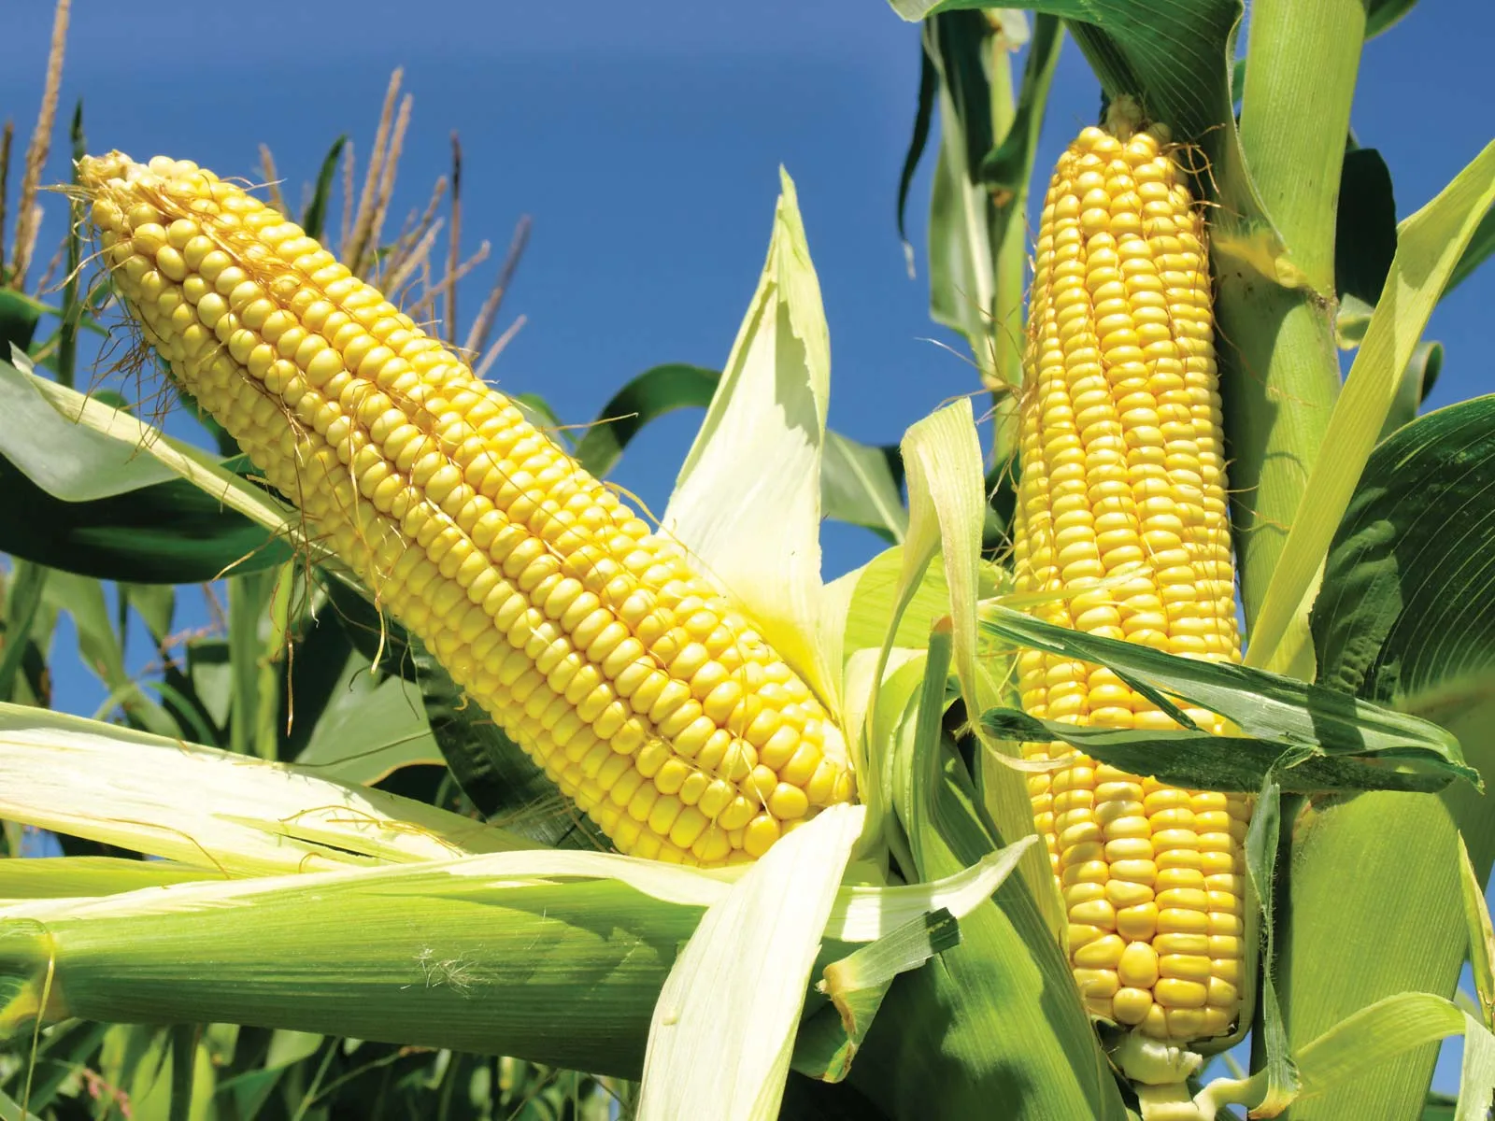
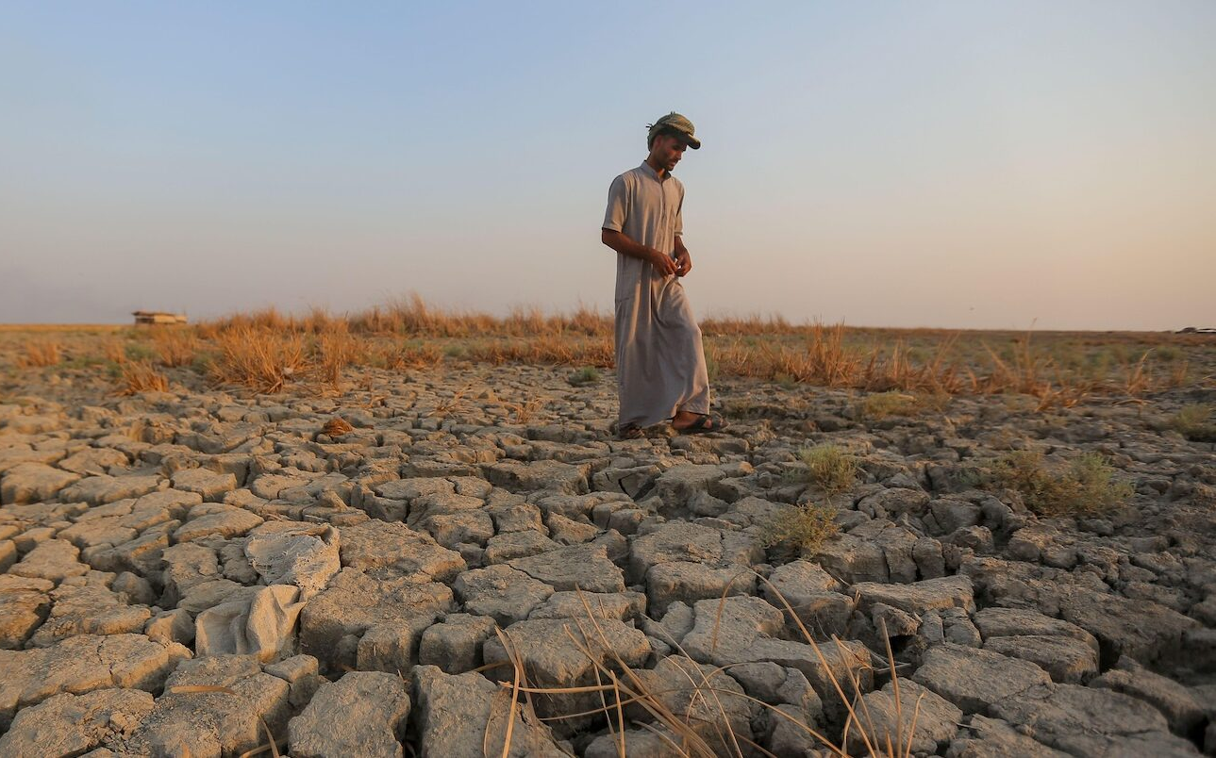
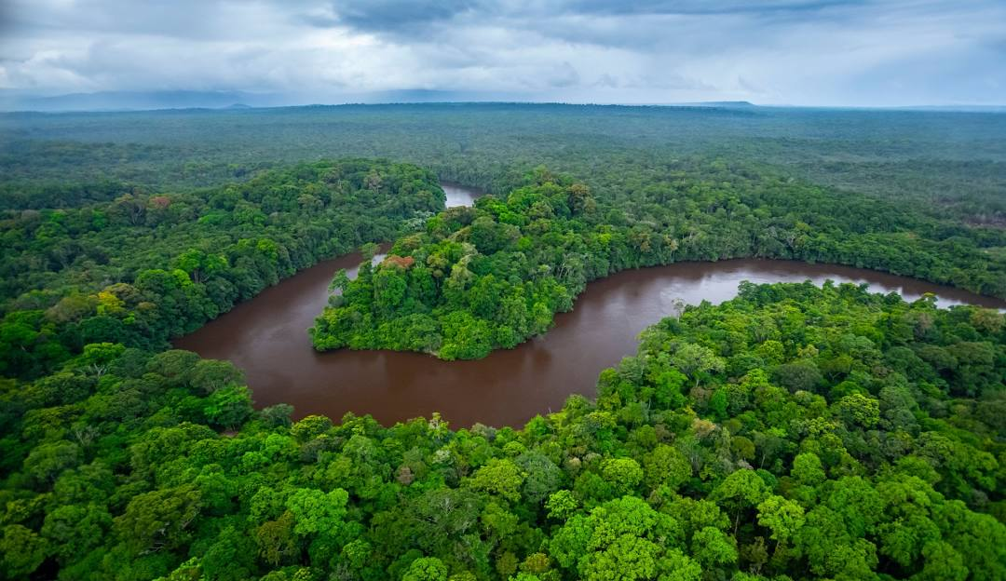
Precipitation warfare
Mean preindustrial precipitation
∆precipitation
Year 100
∆precipitation (SAI – TR)
∆precipitation (SAI – NH)
∆precipitation (SAI – SH)

Slide 30

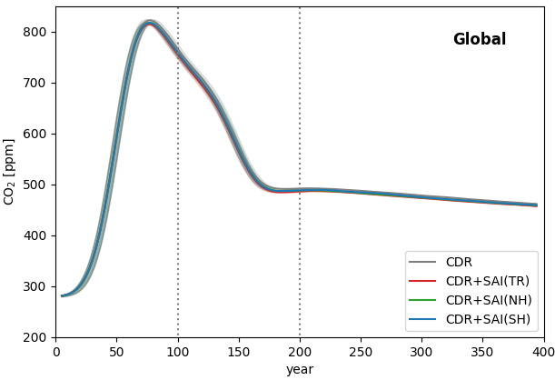
Legacy of SAI
Overshoot avoided
Net zero achieved
Atmospheric CO₂
Climate engineering
https://artlist.io/

Slide 31
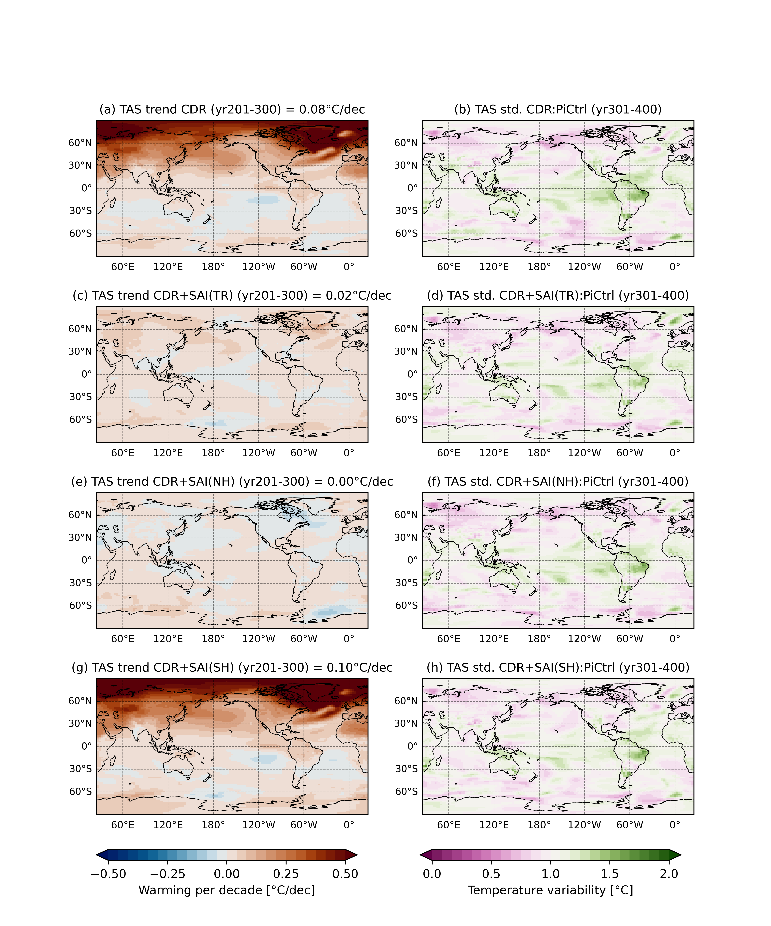
Legacy of SAI
Net zero
Surface temperature
Atmospheric CO₂
Climate engineering

Slide 32
Next generation future scenarios
Van Vuuren et al. (2025)

Slide 33

Summary
CE applications will create regional disparaties
To be effective, CE time scale has to be long
This affects both fast and slow climate feedback
CE will alter stabilizion pathways
CE research is no longer taboo
Much are still poorly understood

Slide 34
Global, polar and tropical mean temperature

